Slide 1
Kafka – 101
Made by a group that learned it recently ;)

Slide 2
Agenda
Docker and Docker Compose
Basics
Setup kafka cluster
Kafka
Fundamentals
CLI tasks
Code tasks and connect to our forum
If time, try extra

Slide 3
Docker
Container Technology 101

Slide 4
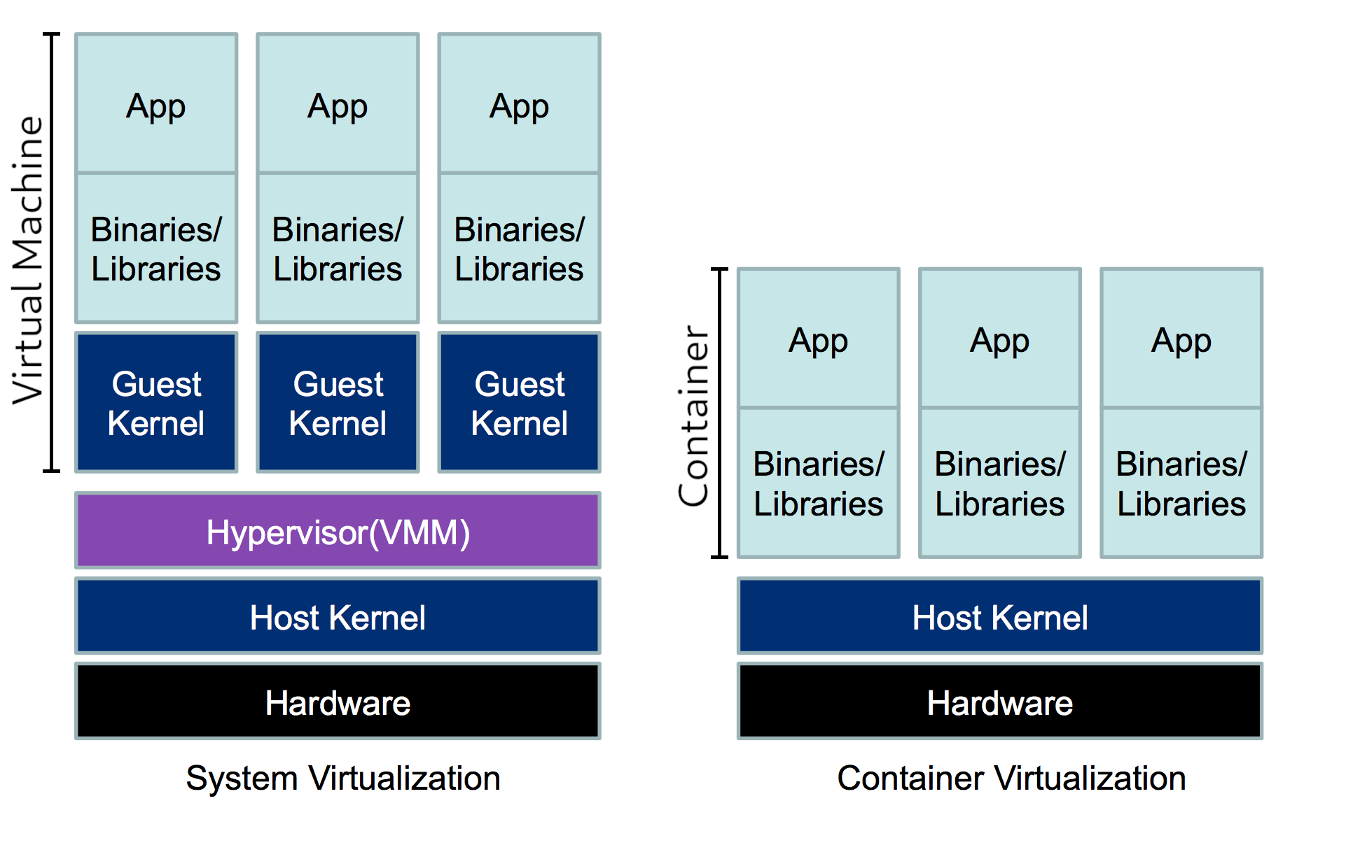
Containers are basically just light weight Virtual Machines. Docker runs containers
Virtual machine stack
Containerised stack

Slide 5
Introduction to Docker and Container Technology
Key Concepts:
Containerization
Isolation
Advantages:
Portability
Efficiency
Use Cases:
Microservices Architecture,
DevOps,
Local development
Notes:
Definition: Docker is an open-source platform that automates the deployment, scaling, and management of applications inside lightweight, portable containers.
Key Concepts:
Containerization: A lightweight, standalone, executable package that includes everything needed to run a piece of software, including the code, runtime, libraries, and system tools.
Isolation: Containers encapsulate applications, ensuring they run consistently across various environments without dependency issues.
Advantages:
Portability: Containers run consistently across different environments, promoting seamless migration and deployment.
Resource Efficiency: Containers share the host OS kernel, reducing overhead and optimizing resource utilization.
Use Cases:
Microservices Architecture: Ideal for breaking down monolithic applications into smaller, manageable services.
DevOps Practices: Enhances collaboration between development and operations teams by providing a consistent environment for development, testing, and deployment.

Slide 6
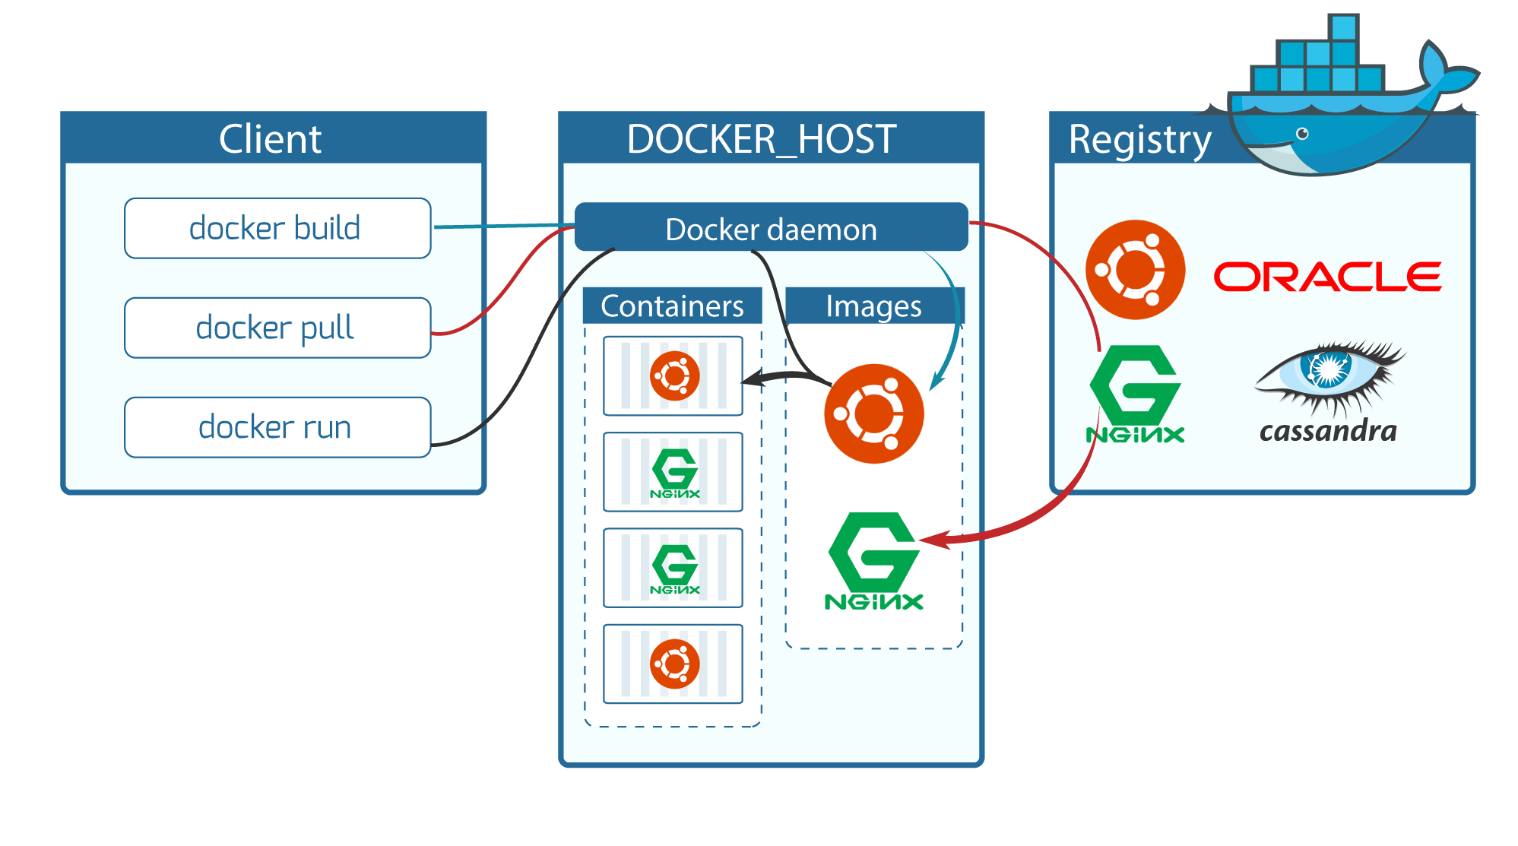
Docker Architecture and Components

Slide 7
Getting started
NB! Docker Desktop is a commercial product and there are licensing stuff to deal with
I recommend going full open source. That means:
Linux: install docker (or moby), or podman via package manager. Remember to add your user to the docker group!
Mac: Colima or podman
Windows: Rancher Desktop

Slide 8
Basic commands
docker pull: Download Docker images from a registry.
docker build: Create a Docker image from a Dockerfile.
docker run: Start a container from a specific image.
docker ps: View active containers.
docker stop/rm: Stop or remove a container.

Slide 9
Docker-compose
If you have a hairy setup (like we will have in this CG course), you can use docker-compose to streamline the process
It is a utility that reads a yaml file and runs appropriate docker commands
Lets you write complex setups declaratively rather than maintaing large scripts of docker commands

Slide 10
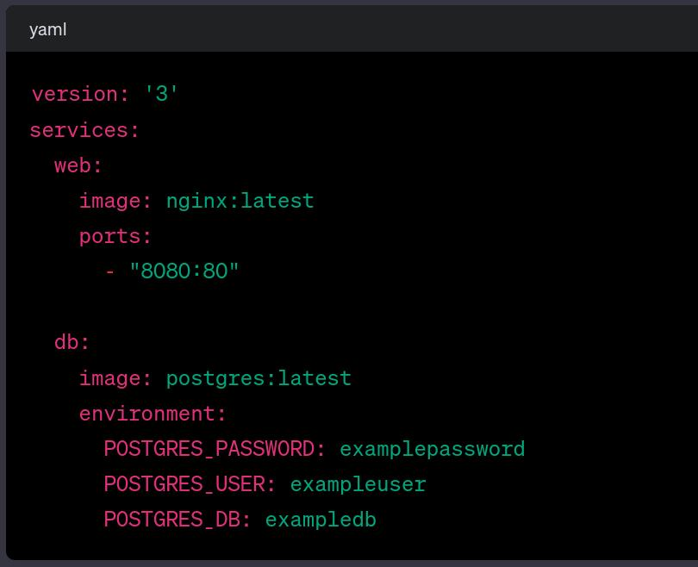
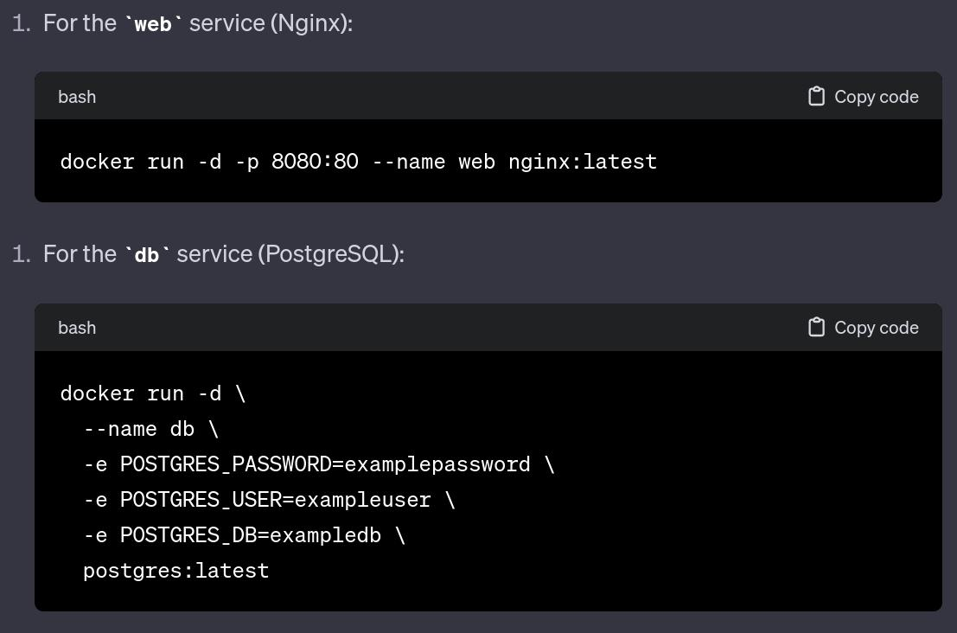
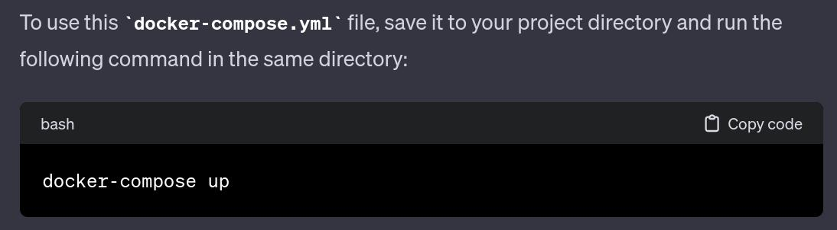
Docker-compose compared to plain docker commands

Slide 11
Lets spin up Kafka
https://github.com/fortedigital/cg-kafka

Slide 12
Short break

Slide 13
Kafka
https://www.gentlydownthe.stream/

Slide 14
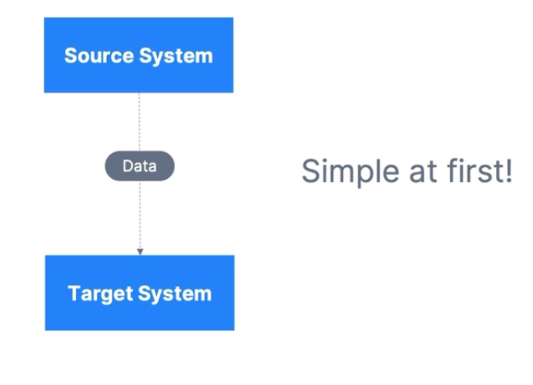
How companies start

Slide 15
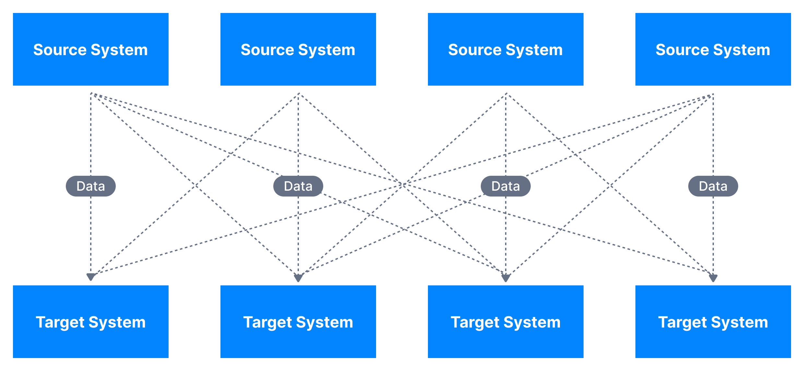
After some time…
A lot more complicated…

Slide 16
This causes problems..
4 source systems, and 4 target systems requires 16 integrations..
Each integration comes with difficulties around
Protocol – how the data is transported (TCP, HTTP, REST, FTP, JDBC…)
Data format – how the data is parsed (Binary, CSV, JSON, Avro…)
Data schema & evolution – how the data is shaped and may change

Slide 17
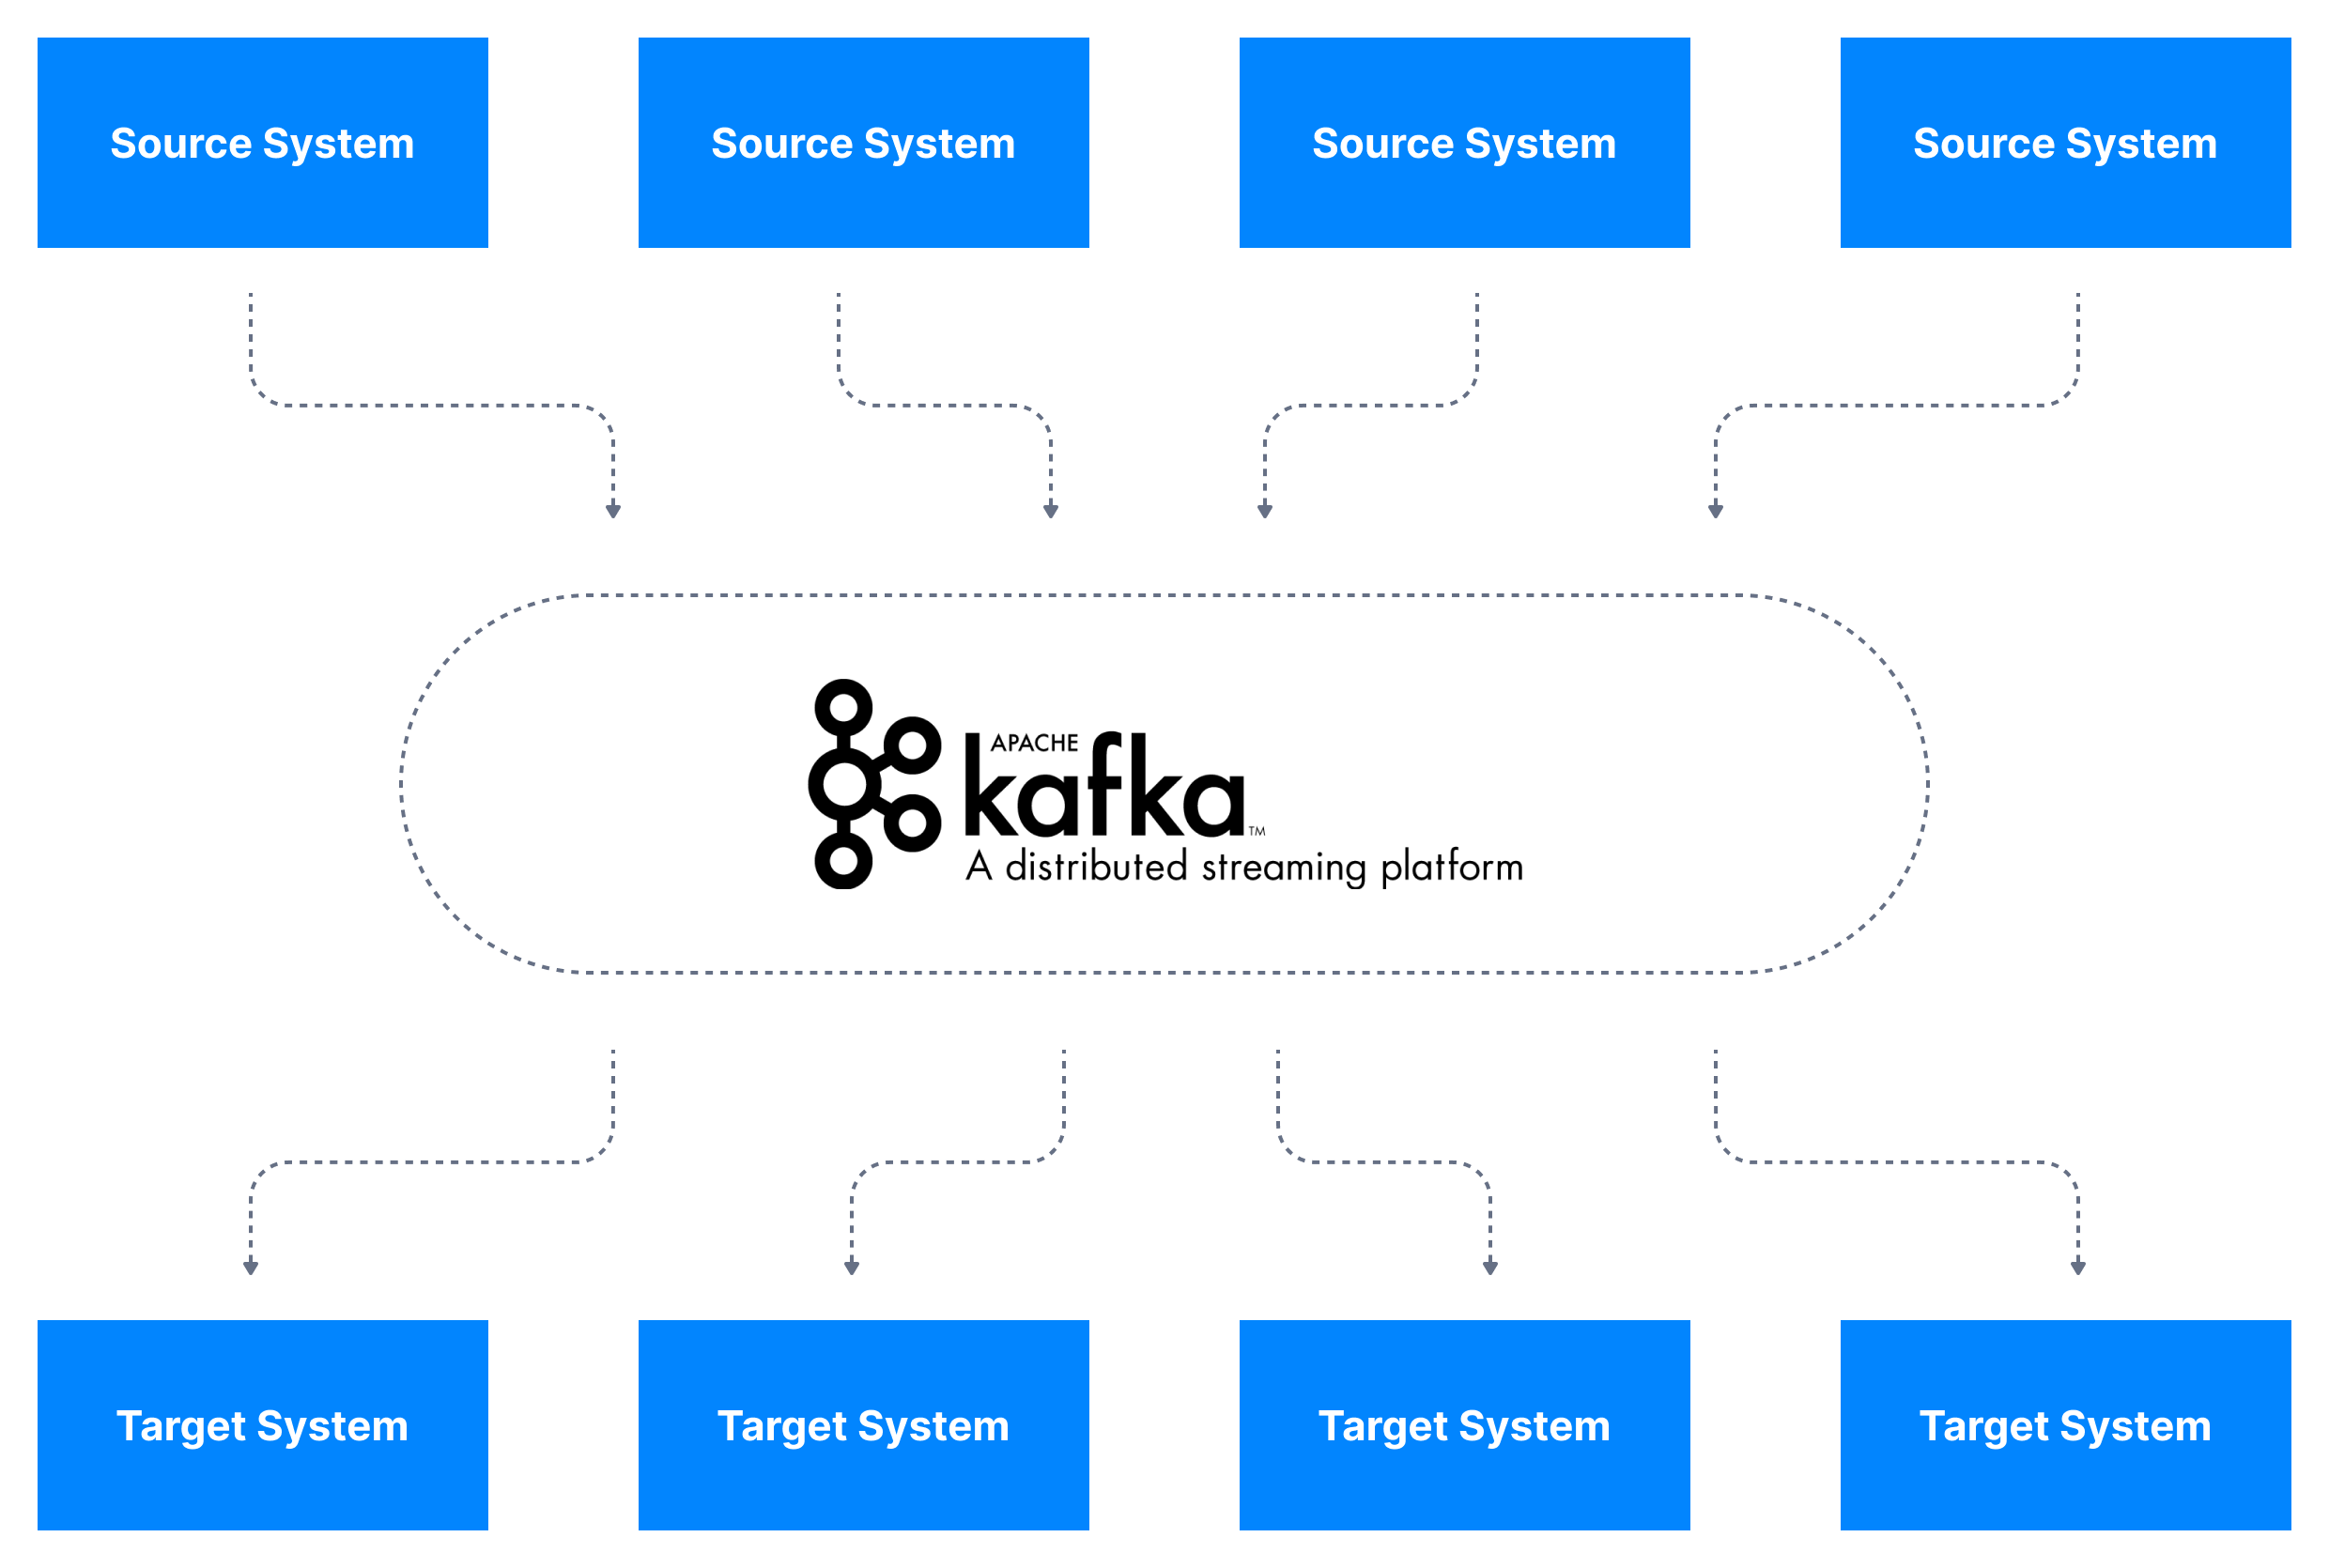
Kafka to the rescue!

Slide 18
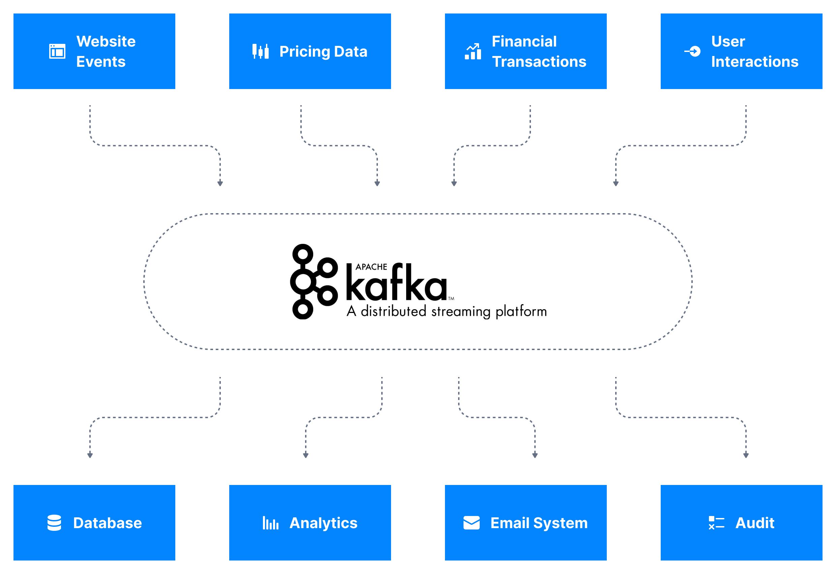
Even better example

Slide 19






Why Apache Kafka
Create by LinkedIn, now Open-Source project maintained by Confluent, IMB, Clourdera
Distributed, resilient architecture, fault tolerant
Horizontal Scalability
Can scale to 100s of brokers
Can scale to millions of messages per second
High performance (latency < 10 ms) – real time
Used by 2000+ companies, 80% of Forune 100

Slide 20
Use cases
Messaging service
Acitivty Tracking
Gathering metrics from many different localtions
Application logs
Stream processing (Kafka streams API)
De-coupling of system dependencies
Integrations with Spark, Flink, Storm, Hadoop and other Big data tech
Mirco-services pub/sub
Event-sourcing store

Slide 21
Examples
Netflix uses kafka for recommendations in real-time while watching
Uber uses kafka to gather user, taxi and trip data in real-time to compute and forecast demand, and compute surge pricing in real-time
LinkedIn uses kafka to prevent spam, collect user interactions to make better connection recommendations in real time.
Ruter uses it for something..
NB: Kafka is used as transportation mechanism of huge data flows that allow these features

Slide 22
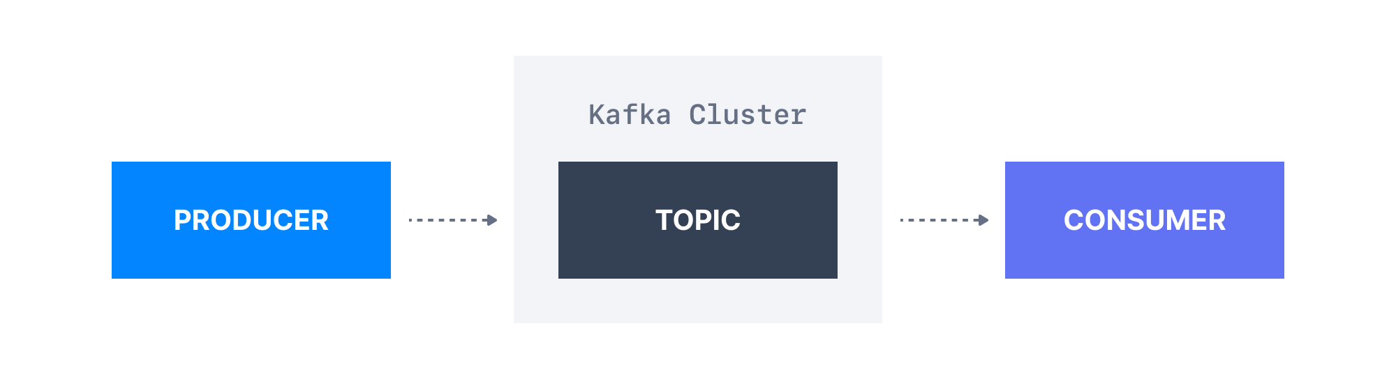
Lets understand kafka better

Slide 23
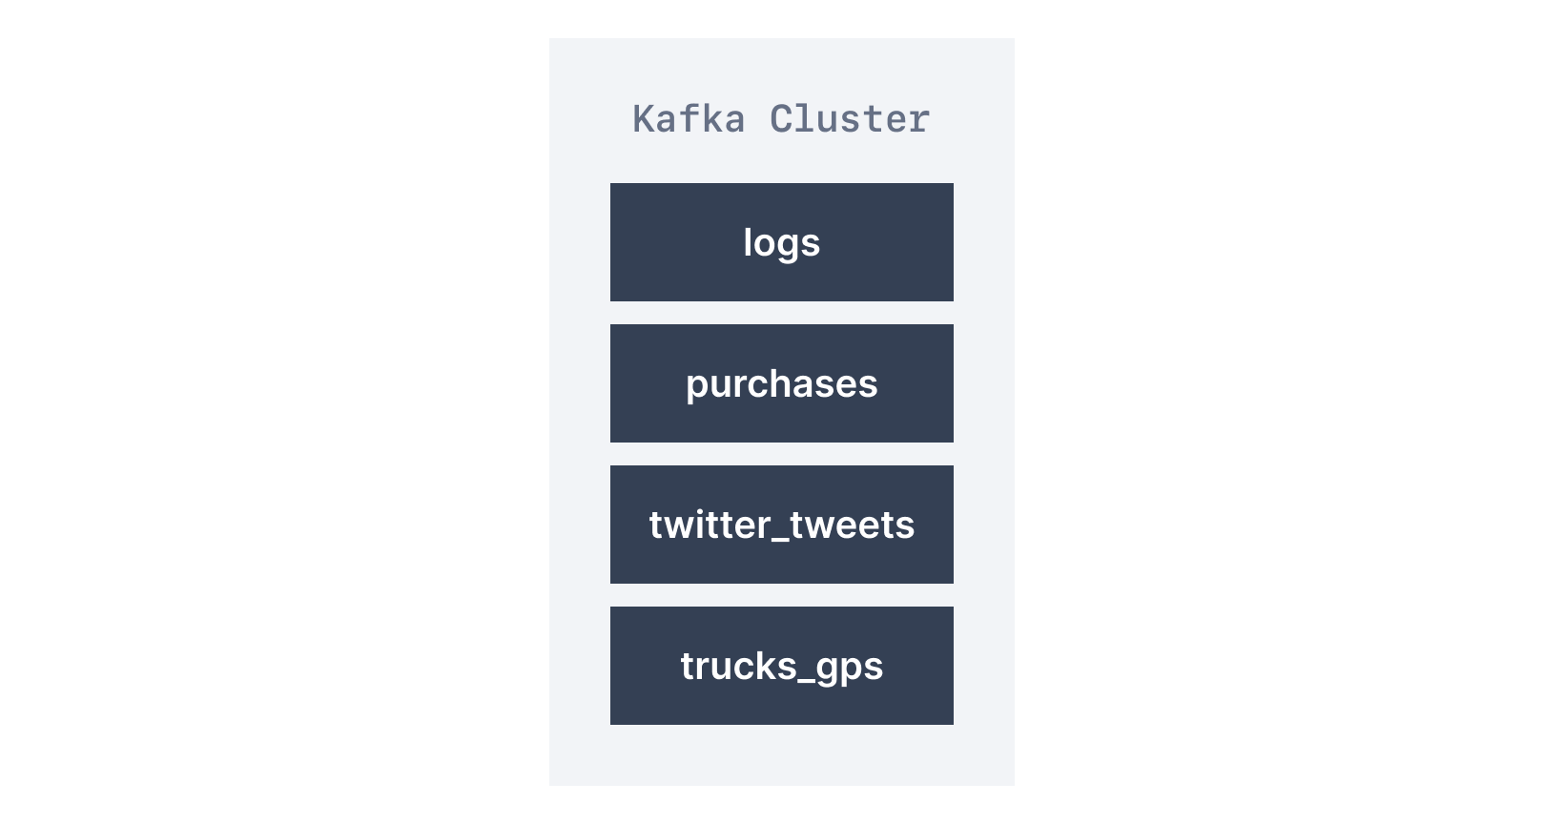
Topics
Topics: A particular stream of data
Like a table in a database
You can have as many topics as you want
Identified by its name
Any kind of message format
A sequence of messages is a data stream
Cannot query messages, use producers and consumer instead.

Slide 24
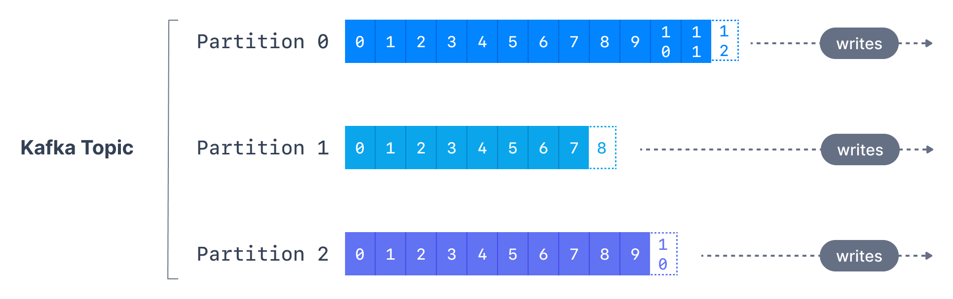
Topics – Partitions and offsets
Topics are split in partitions
Message within each partition are ordered
Each message within a patition gets an incremental ID, called offset
Kafka topics are immutable: once data is written to a partition, it cannot be changed

Slide 25
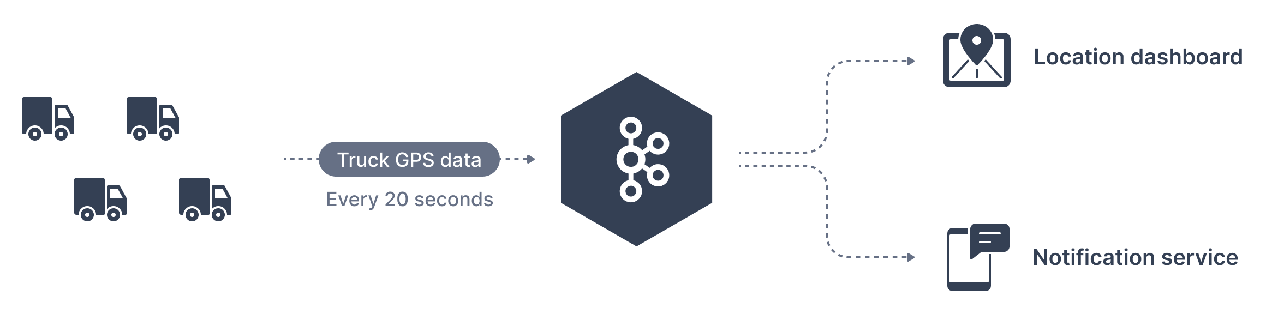
Topic - Example
Fleet of trucks, each truck reports its GPS position to Kafka
Each truck will send a message to Kafka every 20s, each message will contain the truck ID and the truck position(latitude and longitude)
You can have a topic trucks_gps that contains the position of the trucks
We choose to create a topic with 10 partisions (arbitrary number)

Slide 26
Topics – Important notes
Data in partitions is Immutable
Data is kept for a limited time (default 1 week - configurable)
Offset (ID) only has meaning for each partition
Offsets are not reused, or represent the same data between partition
Order is only guranteed within a partition

Slide 27
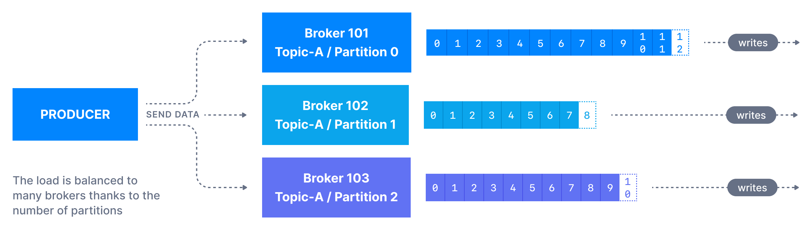
Producers
Producers write data topics (Which are made of partitions)
Prouducers know to which partition to write to (and which broker)
In case of kafka broker failure, producers will recover by connection to new broker

Slide 28
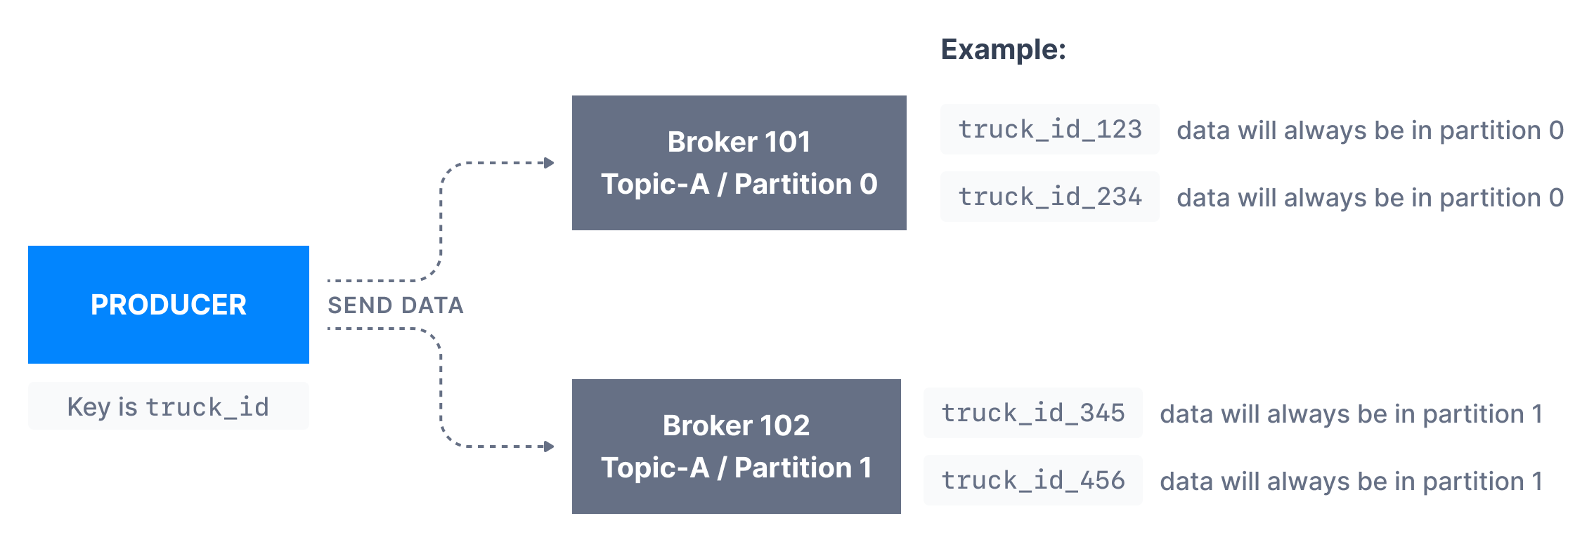
Producers – Message keys
Producers can choose to send a key with the message (string, number etc)
If key=null, data is sent round robin(partition 0, then 1, then 2)
If key != null, then messages with same key go to same partition(hashing)
A key is used for ordering (ex: truck_id)

Slide 29
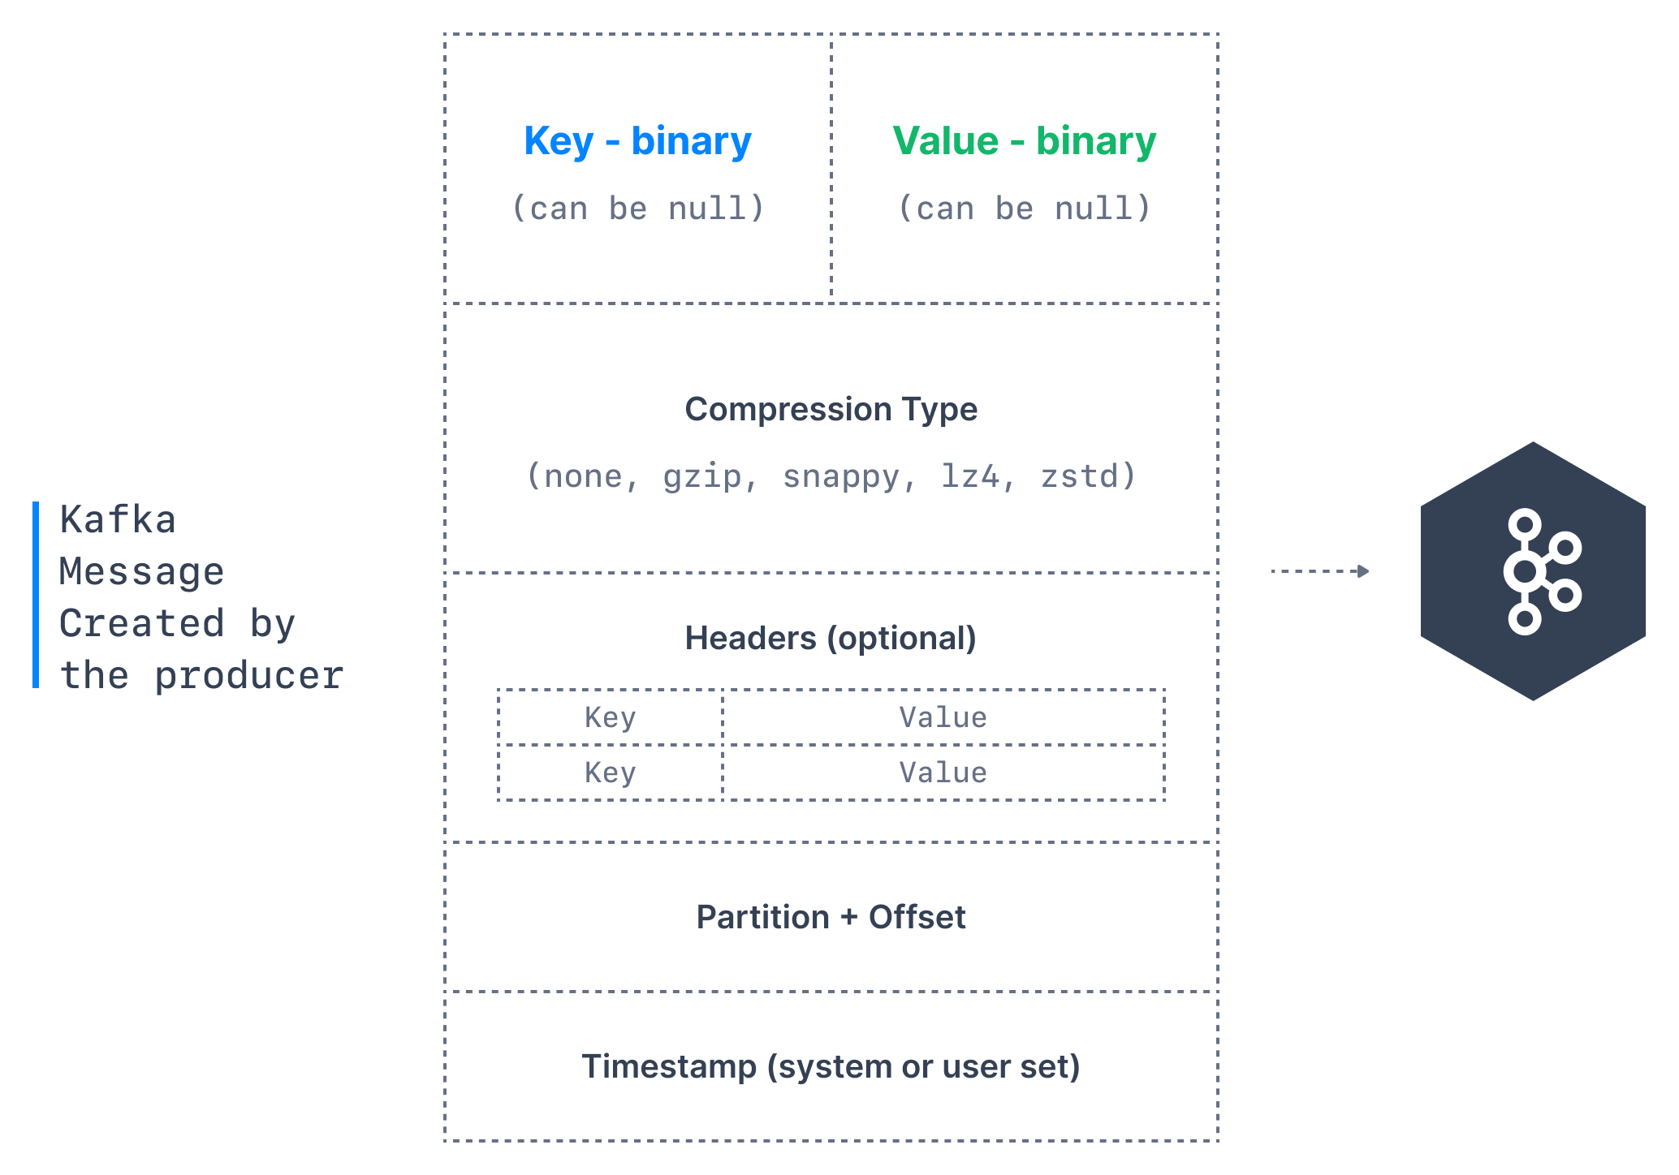
Producer – Message anatomy
Notes:
Key. Key is optional in the Kafka message and it can be null. A key may be a string, number, or any object and then the key is serialized into binary format.
Value. The value represents the content of the message and can also be null. The value format is arbitrary and is then also serialized into binary format.
Compression Type. Kafka messages may be compressed. The compression type can be specified as part of the message. Options are none, gzip, lz4, snappy, and zstd
Headers. There can be a list of optional Kafka message headers in the form of key-value pairs. It is common to add headers to specify metadata about the message, especially for tracing.
Partition + Offset. Once a message is sent into a Kafka topic, it receives a partition number and an offset id. The combination of topic+partition+offset uniquely identifies the message
Timestamp. A timestamp is added either by the user or the system in the message.

Slide 30
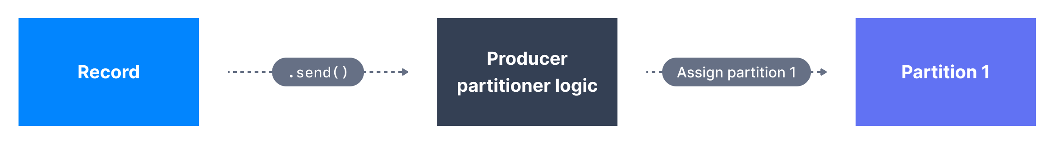
For the curious: Kafka message key hashing
Kafka partitioner is a code logic that takes a record and determines to which partition to send it
By default, Kafka partitoner uses the murmur2 algorithm
targetPartition = Math.abs(Utils.murmur2(keyBytes)) % (numPartitions - 1)
NB: Change numPartitions and ordering is no longer guaranteed…

Slide 31
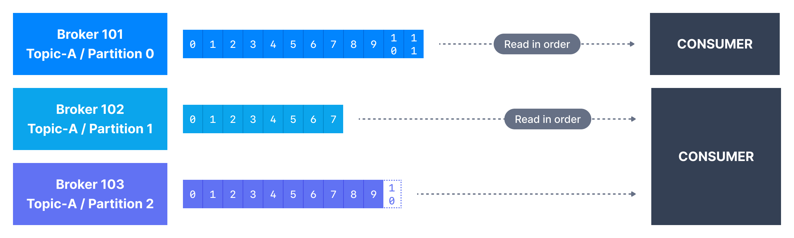
Consumers
Consumers read data from a topic – pull model
Consumers automatically know which broker to read from
In case of broker failure, consumers will recover
Data is read in order, from lowest offset(id) to highest in each partition

Slide 32
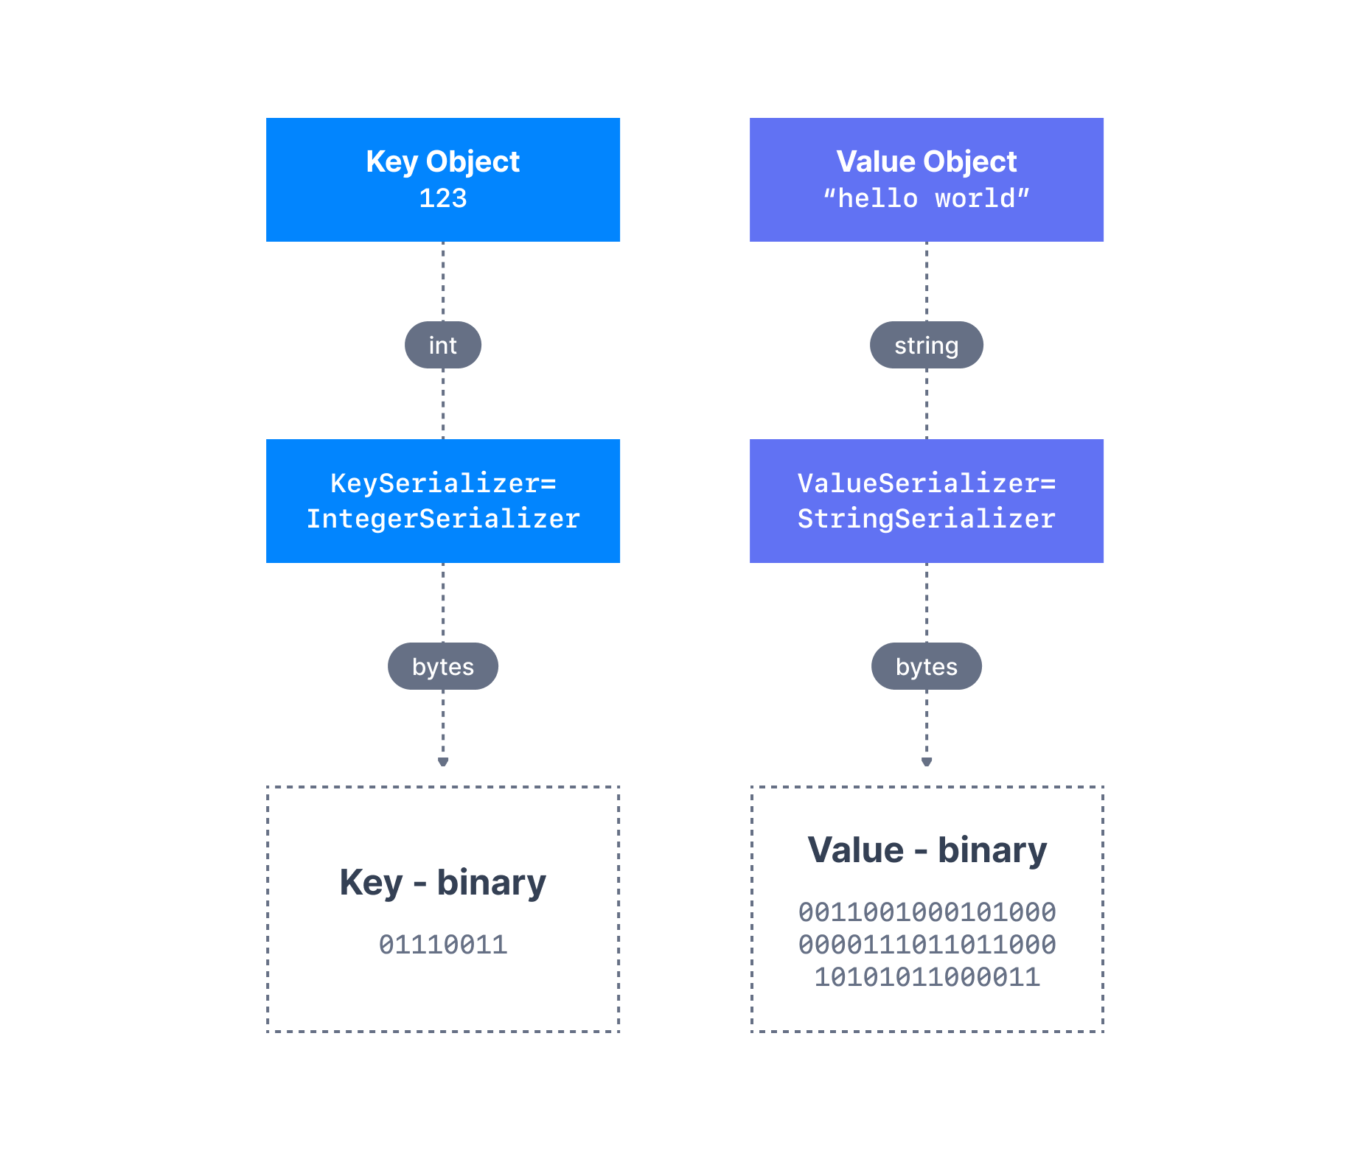
Producer – Message Serializers
Kafka only acceps and sends bytes as input and output
Seralization is used for key and value
Common Serializers
String(incl. JSON)
Int,Float
Avro
Protobuf

Slide 33
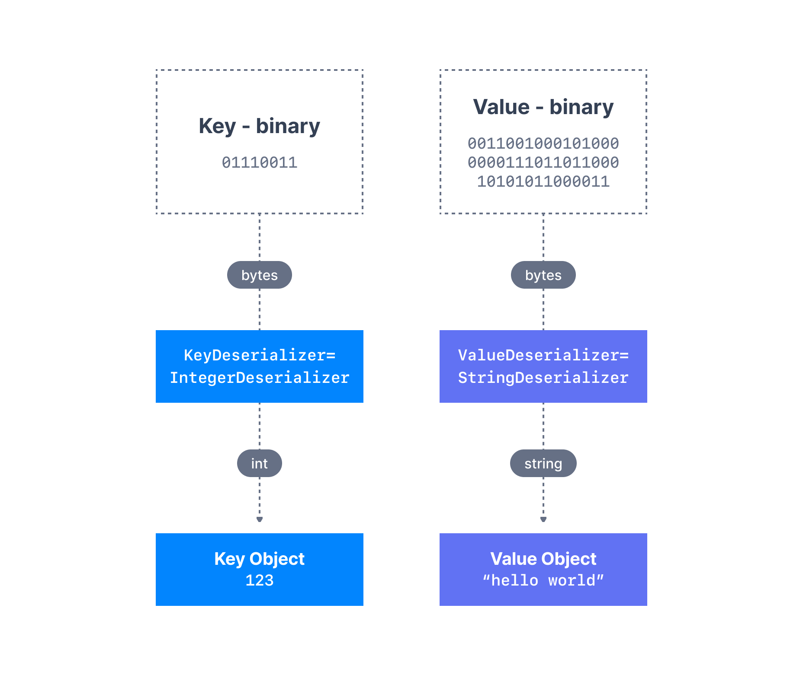
Consumer Deserializer
Deserializer is used for value and key
Common Deserializer
String (incl. JSON)
Int, Float
Avro
Protobuf
The serialization / deserialization type must not change during a topic lifecycle (Create new instead)

Slide 34
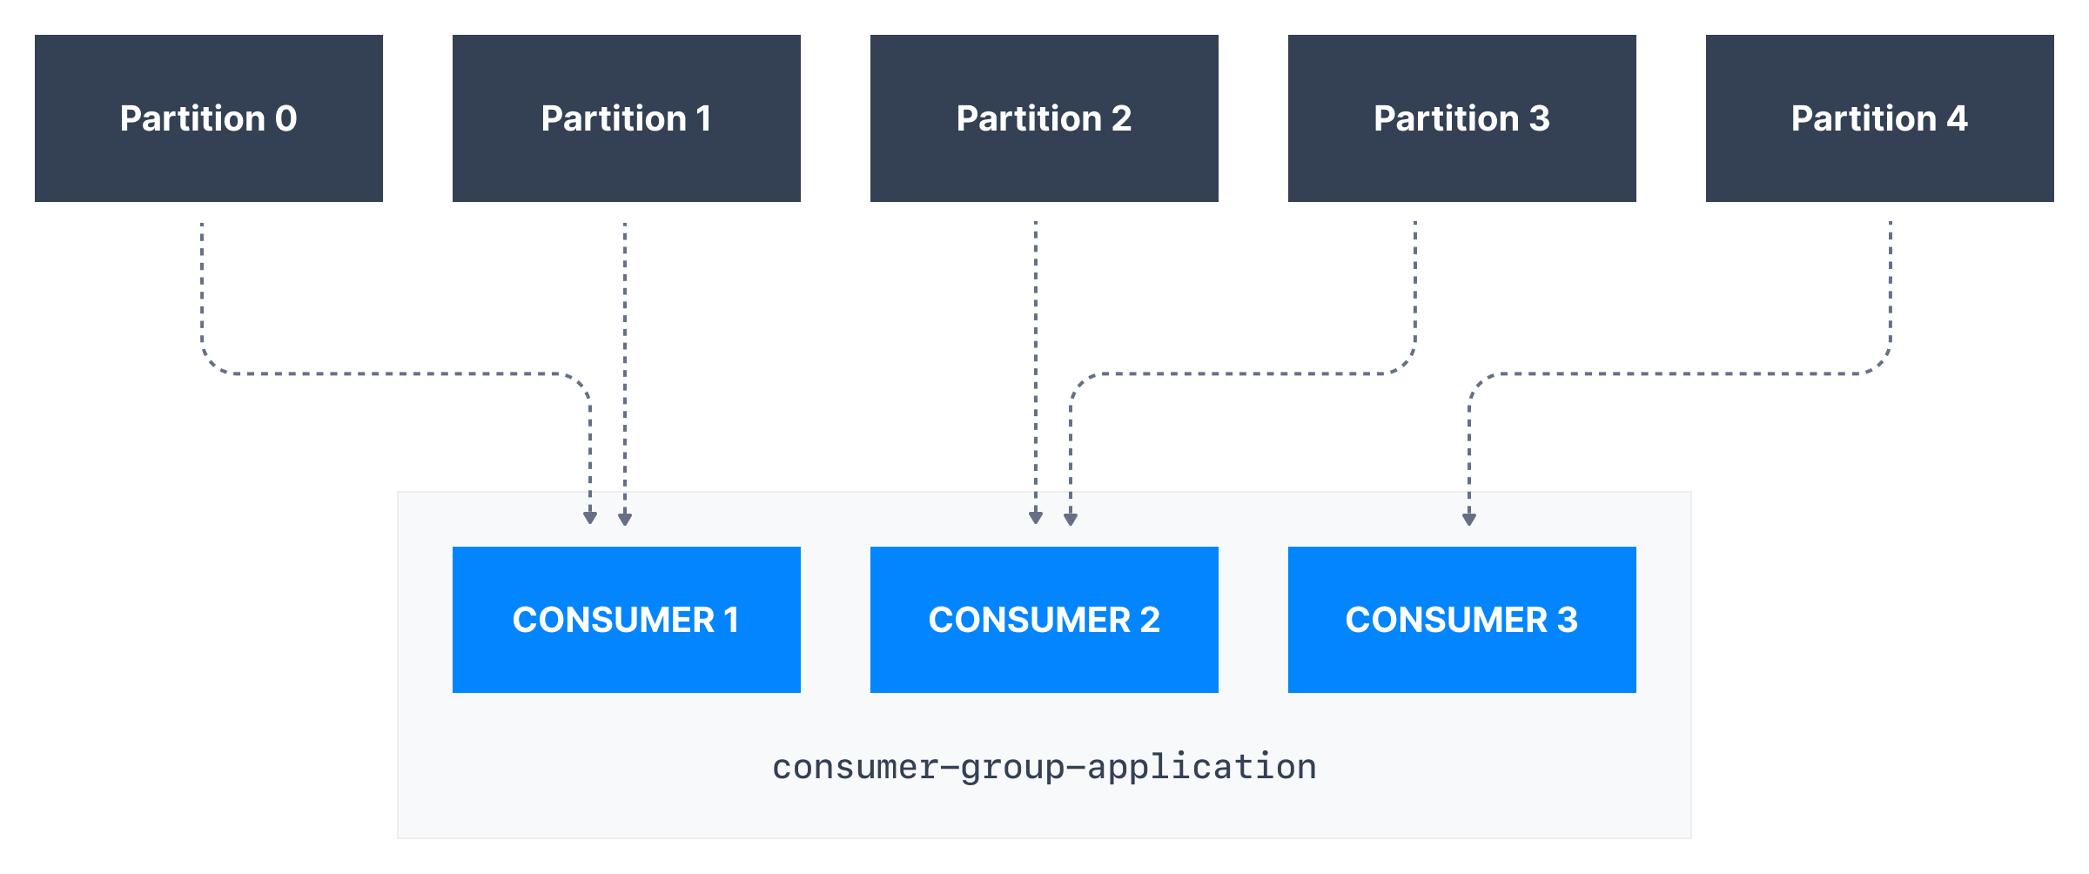
Consumers groups
All the consumers in a application read data as consumer groups
Each consumers within a group reads from exclusive partitions

Slide 35
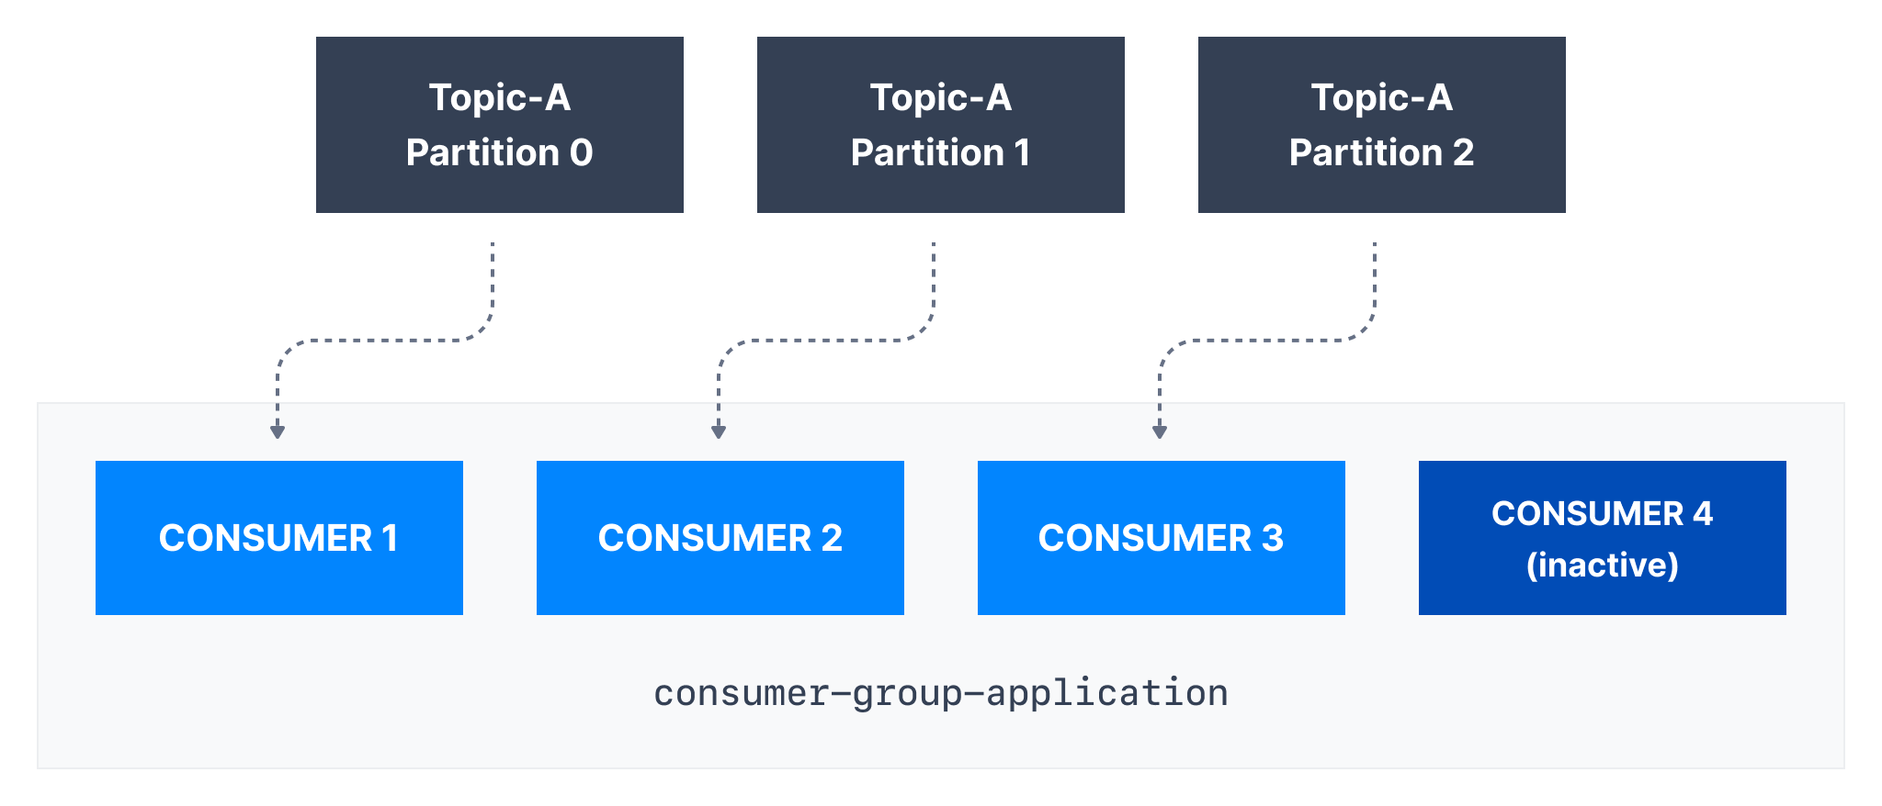
Consumers groups – What if too many consumers?
If you have more consumers than partitions, some concumers will be idle

Slide 36
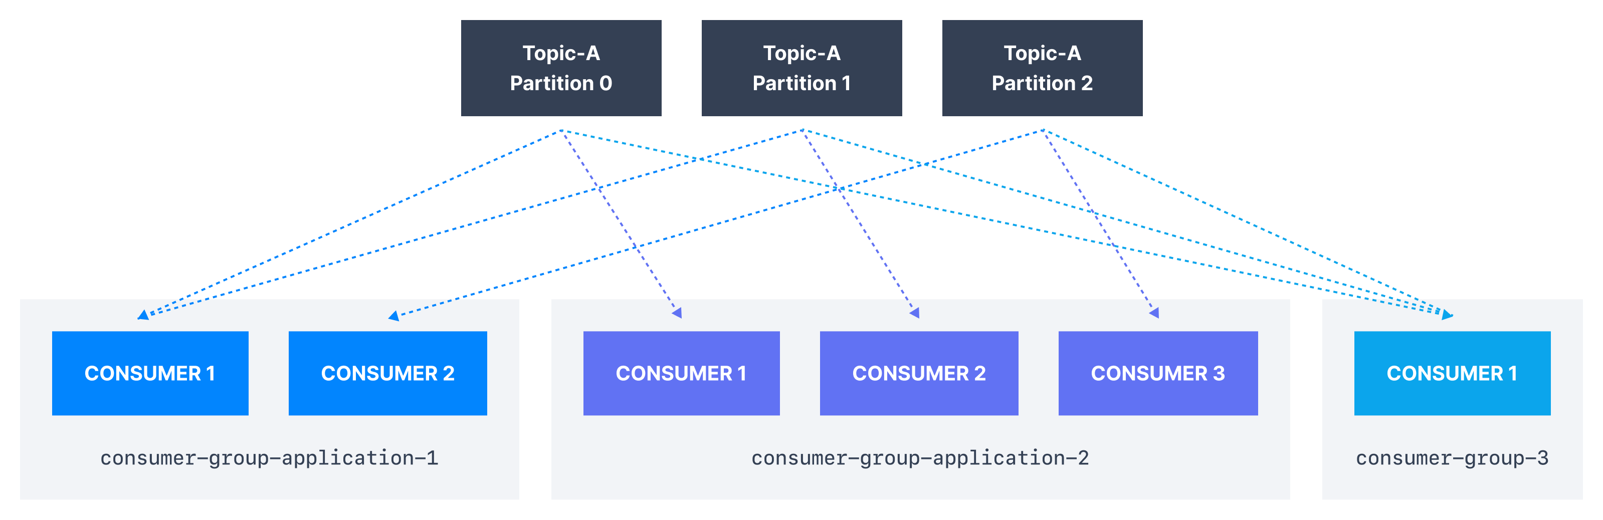
Multiple consumers on one topic
You are allowed to have multiple consumer groups on the same topic
To create distinct consumer group, use the consumer property group.id

Slide 37
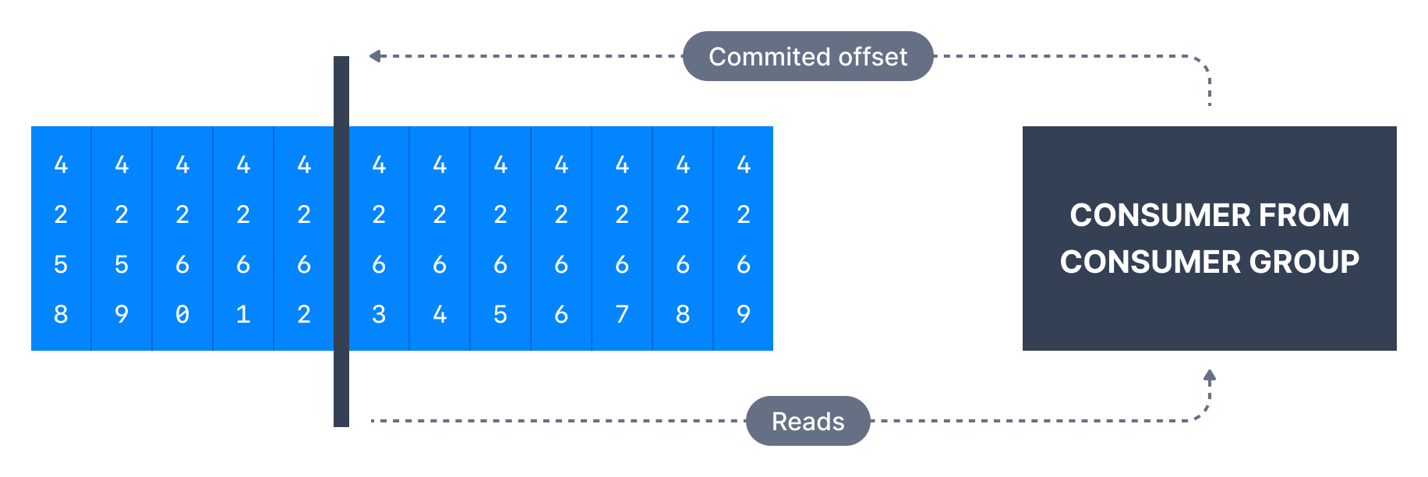
Consumer Offsets
Kafka stores the offsets at which a consumer group has been reading
The offests committed are in a kafka topic named __consumer_offsets
When a consumers processes data it will periodically commit the offset
If consumer dies, it will be able to resume because of the saved offsets

Slide 38
Delivery semantics for consumers
By default, Java consumers will auto-commit offsets (at least once)
There are 3 delivery semantics if you choose to do it manually
At least once
Offsets are commited after message is processed
Duplicates in case of errors, Idemponent consumers is important!
At most once
Offsets are committed as soon as message is reaceived
Messages can be lost
Exactly once
For kafka => Kafka Transactional API (Kafka Streams API)

Slide 39
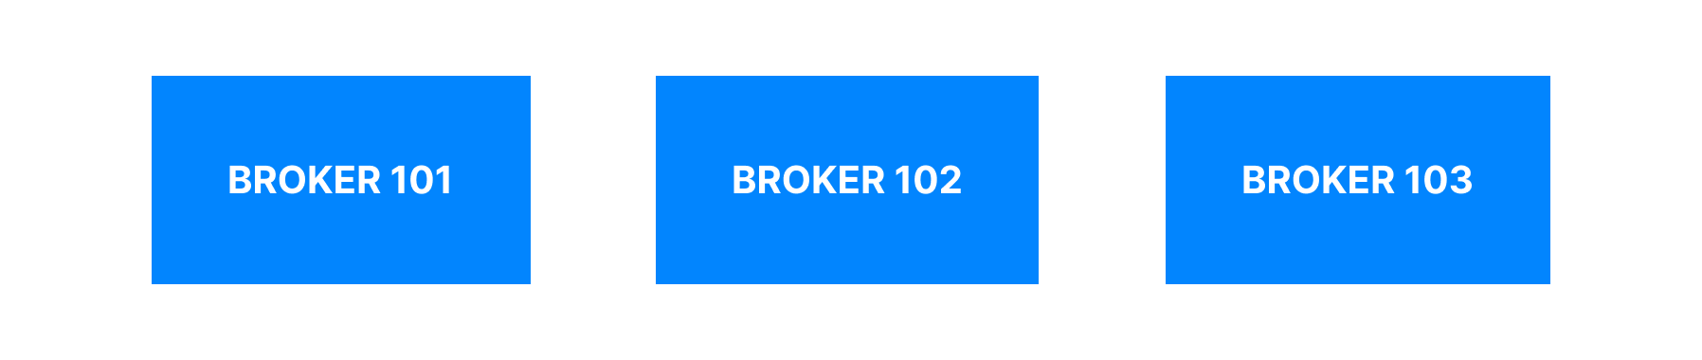
Brokers
A kafka cluster is composed of multiple brokers
Each broker is a identified by ID
Each borker containts a certain topic partitions
Each brokers is a bootstrap server, access point to all other brokers
3 brokers is a good starting point, but some clusters have over 100

Slide 40
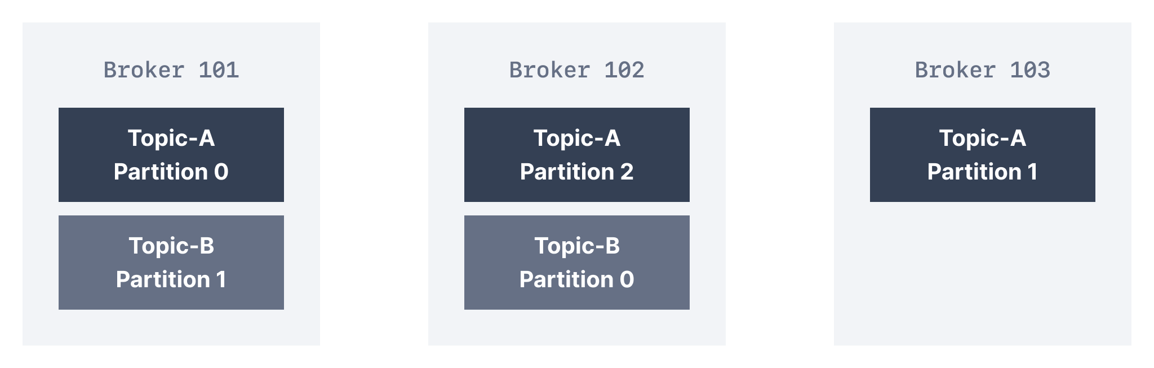
Brokers and topics
Example of Topic-A with 3 partitons and Topic-B with 2 partitions
Note: Data is distributed, and broker 103 doesn’t have any Topic-B

Slide 41
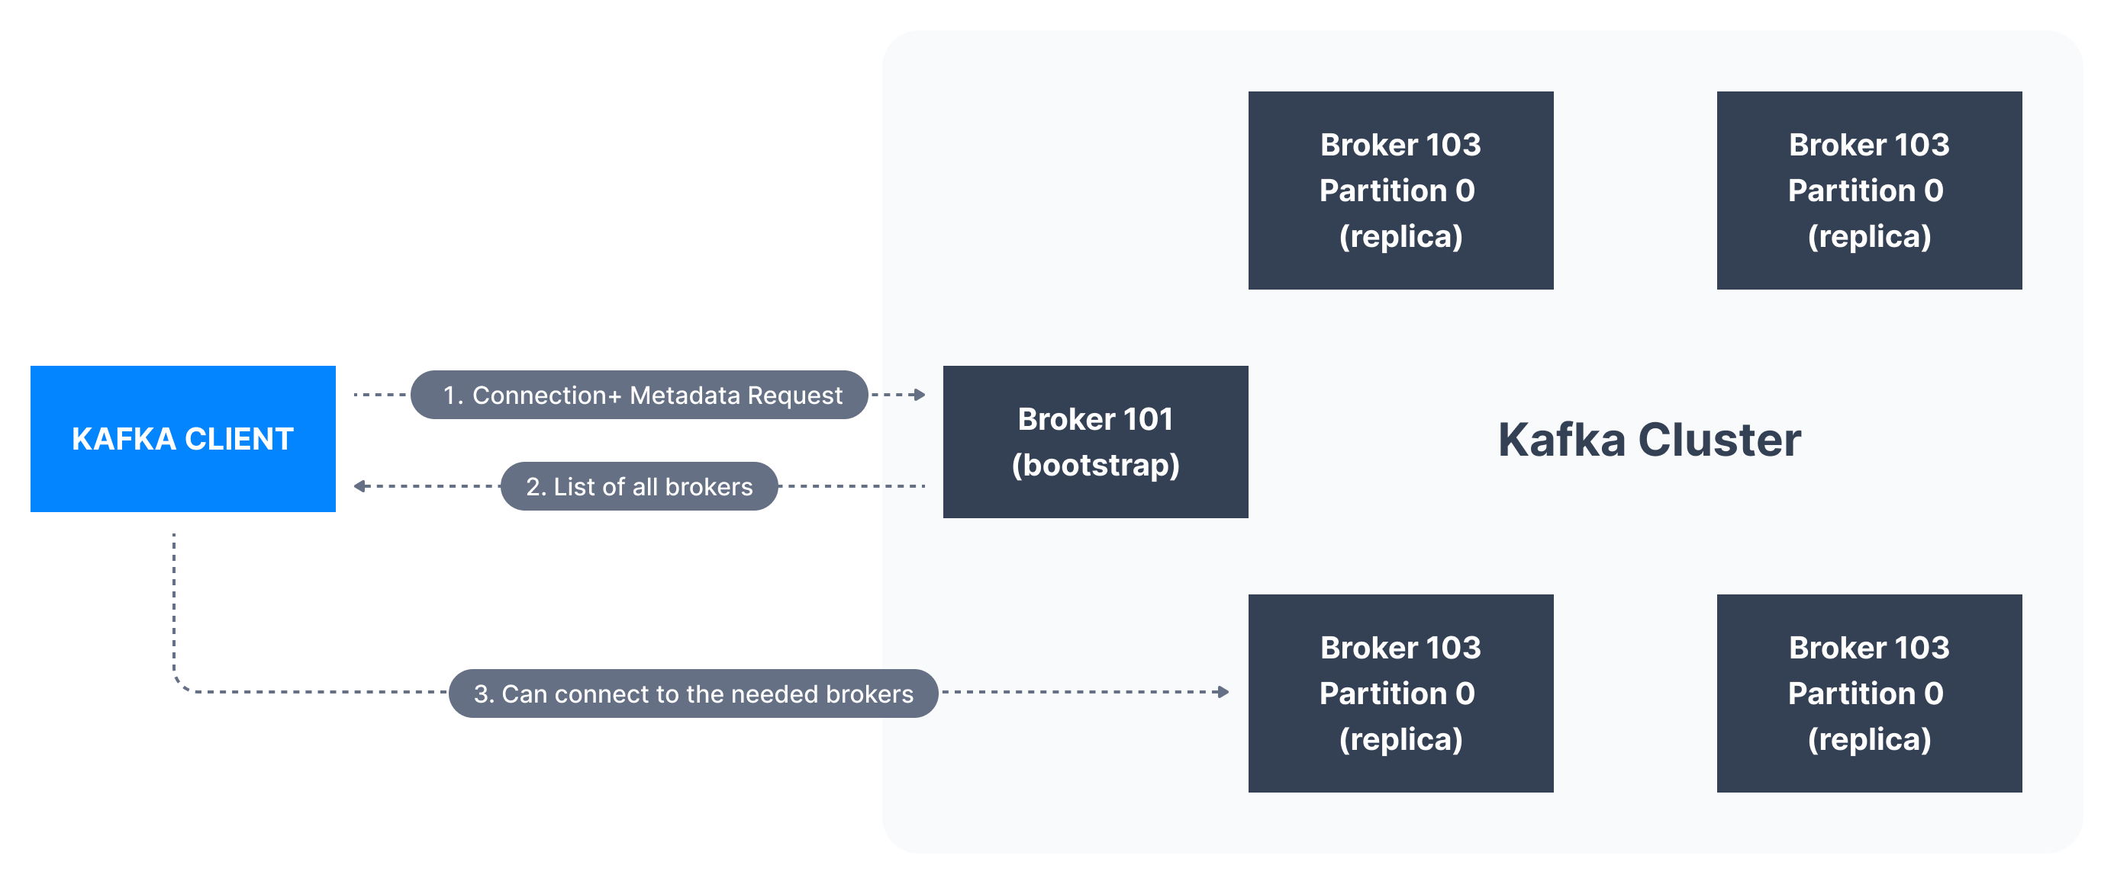
Kafka Broker Discovery
Every Kafka broker is also called a “Boostrap server”
That means that you only need to connect to one broker (Smart clients)
Each broker know about all brokers, topics and partitions

Slide 42
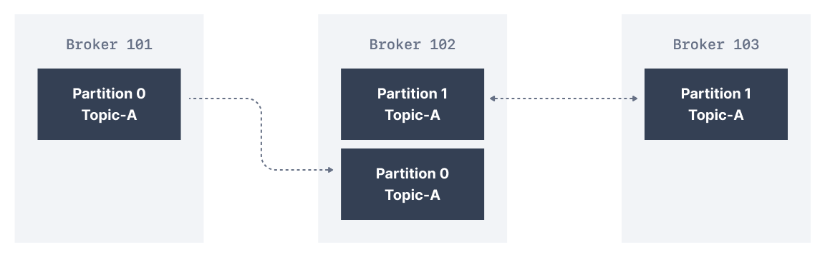
Topic replication factor
Topics should have a replication factor > 1 (usually between 2 and 3)
This way if a broker goes down, antoher broker can serve the data
Example: Topic-A with 2 partitions and relication factor of 2

Slide 43
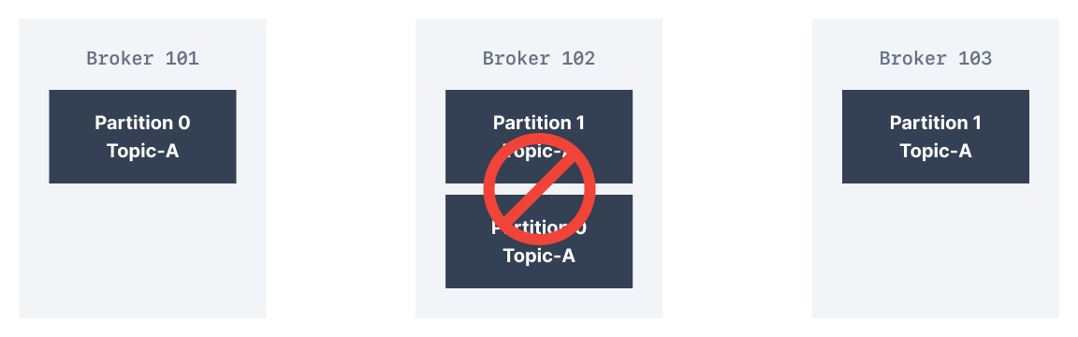
Topic replication factor
Example: We lose broker 102
Result: Broker 101 and 103 can still serve the data
Note: As a rule, for factor N you can lose up to N-1 brokers and still have all your data

Slide 44
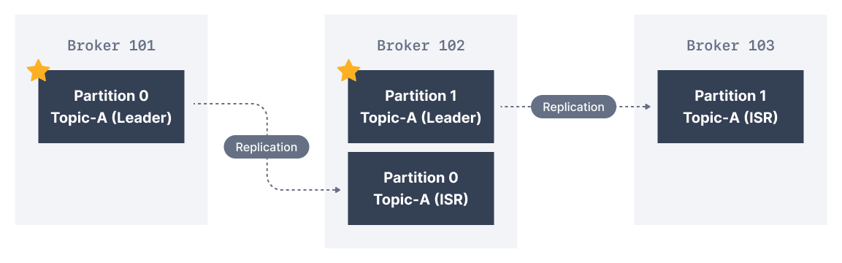
Partition leader
At any time only one broker can be a leader for a given partition
1 preffered leader chosen on topic creation
Leader election if it goes down
Producers can only send data to the broker that is leader of a partition
Each partition has one leader and multiple ISR(in-sync replica)

Slide 45
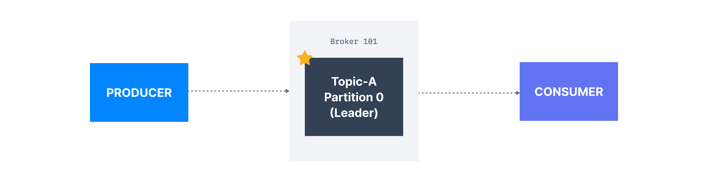
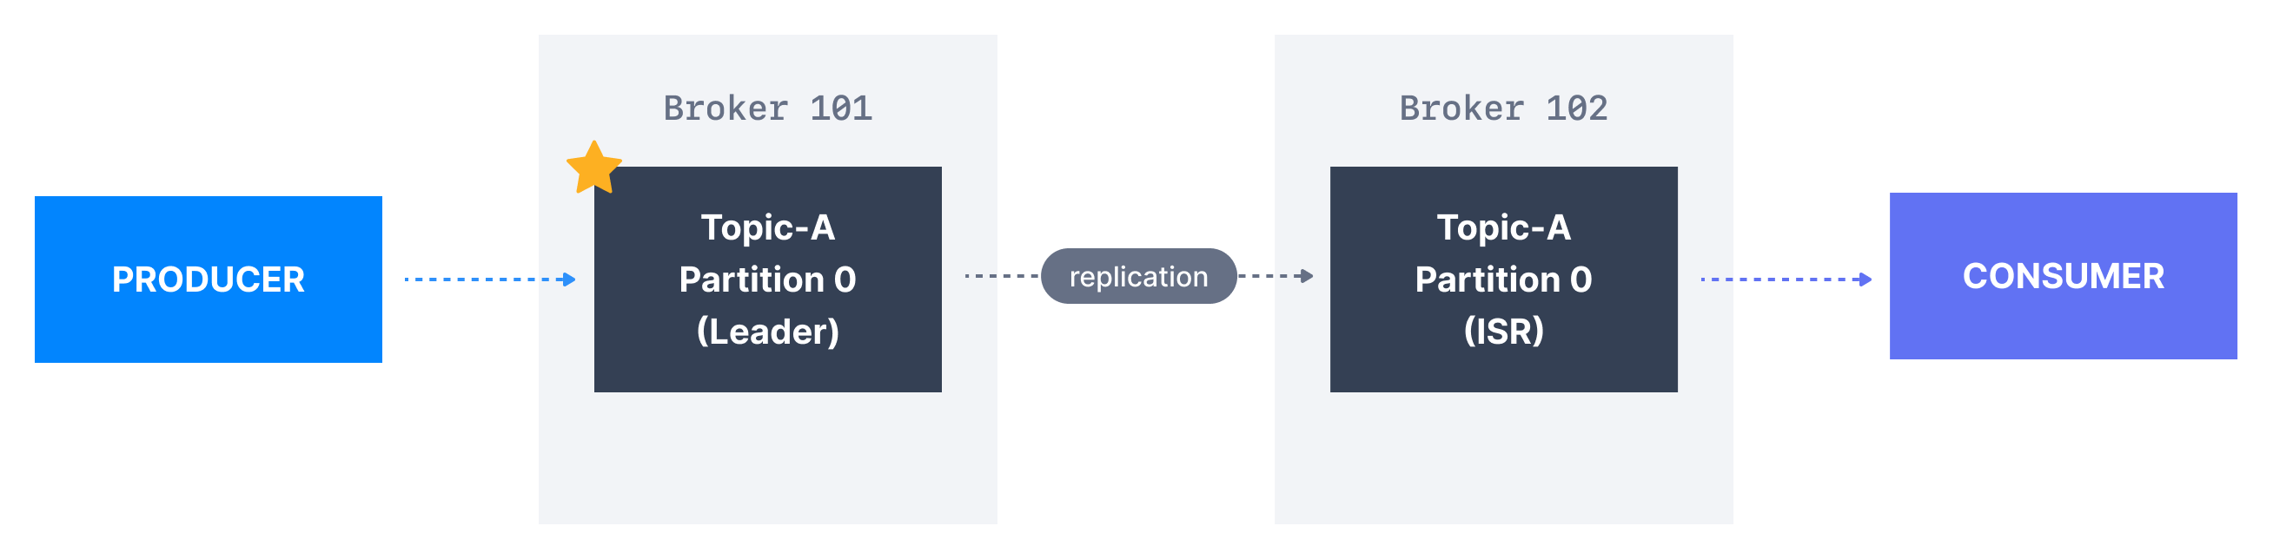
Default behavior for Producer/Consumer
Producers send to the leader of the partition
Consumers read from the leader, but can also read from replicas (>= v2.4)

Slide 46
Producer Acknowledgements (acks)
Producers can choose to receive acknowledgments of data writes
acks=0: Producers won’t wait for acknowledgement (possible data loss)
acks=1: Producers will wait for leader acknowledgment (limited data loss)
acks=all=-1: Leader + replicas acknowledgment (no data loss)

Slide 47


Zookeeper
Zookeeper manages brokers (Keeps a list of them)
Zookeeper helps in performing leader election
Zookeper sends notifiction to kafka in case of changes (e.g. new topic, delete topics, broker dies, etc…)
Kafka 2.x cant work without zookeeper
Kafka 3.x can work without Zookeeper – Kafka raft
Kafka 4.x will not have Zookeeper

Slide 48
Should you use Zookeeper?
With kafka brokers
Kafka Raft (KRaft) is production ready as of 3.3 (now 3.6)
4.0 is planned to be released in April 2024
Yes & No
With Kafka Clients
Over time, the kafka clients and CLI have been migrated to leverage the brokers as connection endpoint

Slide 49
About Kafka KRaft
In 2022, the Apache Kafka project stated to work to remove Zookeeper
Zookeper shows scaling issues when kafka clusters have > 100 000 partitions
By removing Zookeeper
Ability to scale to millions of partitions, easier to maintain and set up
Improved stability, easier to monitor, support, and administer
Single process to start Kafka
Single security model for the whole system
Faster controller shutdown and recovery time

Slide 50
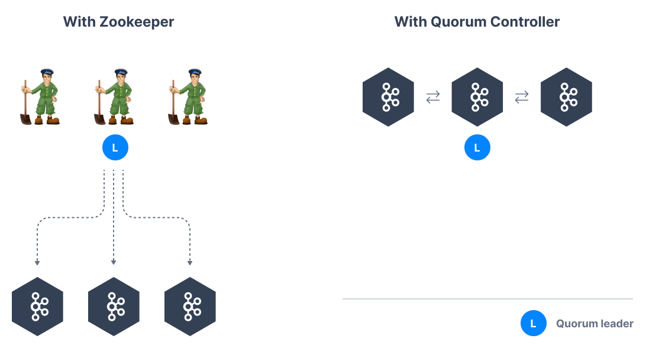
Kafka KRaft - Architecture

Slide 51
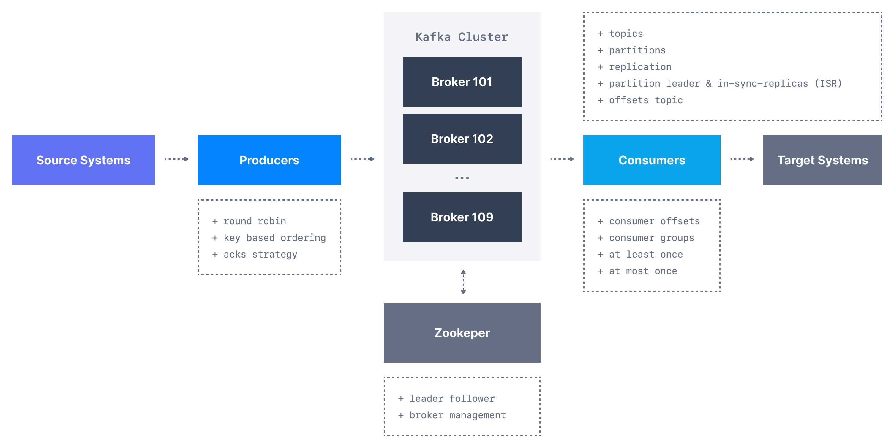
Theory – Round-up

Slide 52
Sources – since that is important now a days
https://www.udemy.com/course/apache-kafka/
https://www.conduktor.io/kafka/
Most of the kafka images are from here

Slide 53
Short break

Slide 54
To the tasks!
GitHub
CLI
Code
Forum
extra

Slide 55
Til neste gang
Kafka Schema Regsitry
Kafka Streams
Manipulering av Data
Kafka Connect
Code by others for sending data to and from kafka easier
Kafka ksql
SQL like querying of Kafka topics

Slide 56
Kafka – 102
Made by a group that learned it recently ;)

Slide 57
Agenda
Resume workshop 1
Start or resume the Code task from workshop 1
Add Schema registry
Wikimedia
Producer & Consumer
Add Schema registry
Kafka Connect
Kafka Rest Proxy

Slide 58
Resume workshop 1
If you have any questions, please reach out to us.

Slide 59
Short break

Slide 60
Schema Registry
https://github.com/fortedigital/cg-kafka

Slide 61
Producer – Message Serializers
Kafka only acceps and sends bytes as input and output
Seralization is used for key and value
Common Serializers
String(incl. JSON)
Int,Float
Avro
Protobuf

Slide 62
Consumer Deserializer
Deserializer is used for value and key
Common Deserializer
String (incl. JSON)
Int, Float
Avro
Protobuf
The serialization / deserialization type must not change during a topic lifecycle (Create new instead)

Slide 63
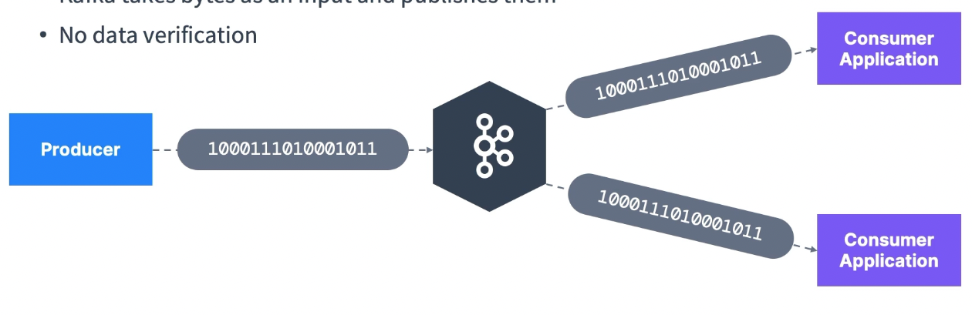
The need for a schema registry
Kafka takes bytes as an input and publishes them
No data verification
What if Producer sends bad data?
What if a field gets renamed?
What if the data format changes from one day to another?
The consumers break!!

Slide 64
The need for a schema registry
We need data to be self describable
We need to be able to evolve data without breaking downstream consumers
We need schemas… and a schema registry
What if the kafka brokers were verifying the messages they receive?
It would break what makes kafka so good
Kafka doesn’t parse or even read you dara (no CPU usage)
Kafka takes bytes as an input without even loading them into memory (Zero copy)
Kafka distributes bytes
As far as Kafka is concerned, its doesn’t even knw if your data is an integer, a string etc

Slide 65
The need for a schema registry
The schema registry must be a separate component
Producers and Consumers nee to be able to talk to it
The schema registry must be able to reject bad data
A common data format must be agreed upon
It nees to support schemas
It needs to support evolution
It needs to be lightweight
Enter.. The Schema Registry
And Apache Avro as the data format(Protobuf, JSON is supported)

Slide 66
Pipeline without Schema Registry

Slide 67
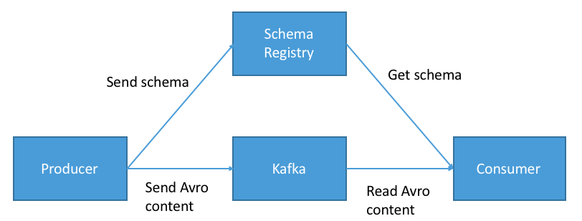
Schema Registry - Purpose
Store and retreive schemas for Producers/Consumers
Enforce Backward / Forward / Full compatibility on topics
Decrease the size of the payload of data sent to kafka

Slide 68
Schema Registry - Gotchas
Utilizing a schema registry has a lot of benefits
BUT it implies you need to
Set it up well
Make sure it’s highly available
Partially change the producer and consumer code
Apache Avro as a format has a learning curve
Other formats include protobuf and JSON Schema
The Confluent Schema Registry is free and source-available
Other open-source alternatives may exist

Slide 69
Kafka Connect

Slide 70
Why Kafka Connect
Kafka v0.9.x (Nov 2015)
Kafka Connect API was introduced
Interface for creating connectors
https://Confluent.io/hub
Four Common kafka use Cases
Source => Kafka – Producer API – Kafka Connect Source
Kafka => Kafka – Consumer & Producer API – Kafka Streams
Kafka => Sink – Consumer API – Kafka Connect Sink
Kafka => APP – Consumer API

Slide 71
Why Kafka Connect
Programmers always want to import data from the same sources:
Databases, JDBC, Blockchain, Cassandra, DynamoDB, CosmosDB, MongoDB, MQTT, Salesforce, Twitter etc…
Programmers always want to store data in the same sinks:
S3, ElasticSearch, HDFS, JDBC, SAP, DocumentDB, Cassandra, DynamoDB, MongoDB, Red etc…
It is tough to achieve fault tolerance, exactly once processing, distribution, ordering.
Other programmers may have already done a very good job!

Slide 72
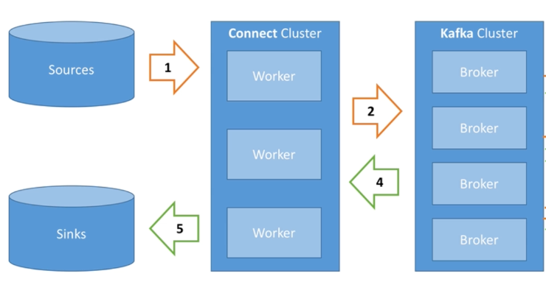
Kafka Connect - Architecture

Slide 73
Kafka Connect – High Level
Source Connectors to get data from common data sources
Sink Connectors to publish data to common data stores
Make it easy for non-experienced dev to quickly get their data reliably into Kafka
Can be part of your ETL pipeline
Scaling made easy with workers
Re-usable code!

Slide 74
Kafka Connect - Concepts
Kafka Conenct cluster has multiple loaded Connectors
Each connector is a re-usable piece of code (java jars)
Kafka Connect API – Spec for java connectors
Many conenctors exists in the open source world, leverage them!
Connect + User configuration => task
A task is linked to a connetor configuration
A job configuration may spawn multiple tasks
Tasks are executed by Kafka Connect Workers(Servers)
A woker is a single java process
A worker can be standalone or in a cluster

Slide 75
Kafka Connect - Distributed
Multiple workers run your connectors and tasks
Configuration is submitted using a REST API
Easy to scale, and fault tolerant (rebalancing in case a worker dies)
Useful for production deployment of connectors

Slide 76
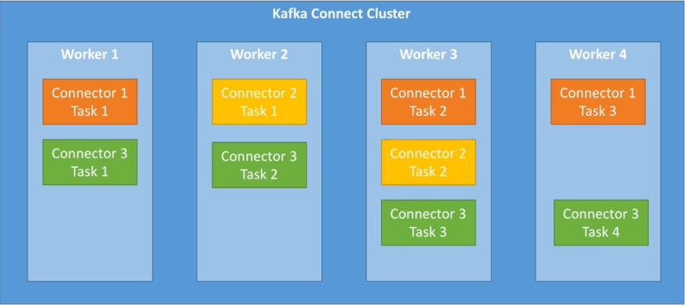
Kafka Connect – Distributed

Slide 77
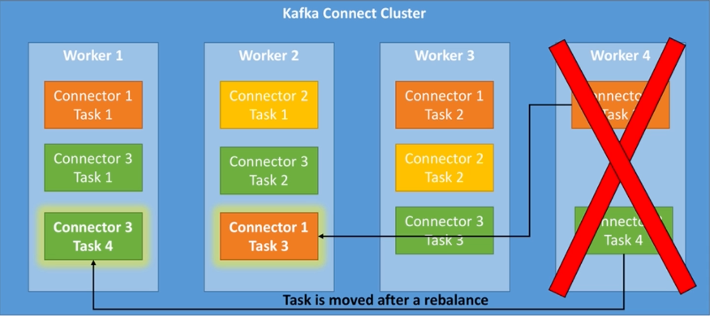
Kafka Connect – Distributed

Slide 78
Kafka Connect API & Rest Proxy
All the actions performed in the Kafka connect UI are actually triggering REST API calls to Kafka Connect.
The same can be done for Kafka itself through Kafka Rest Proxy
Simply explained it’s a API layer on top of Kafka
https://docs.confluent.io/platform/current/kafka-rest/api.html#crest-api-v2

Slide 79
Sources – since that is important now a days
https://www.udemy.com/course/apache-kafka/
https://www.udemy.com/course/kafka-connect/
https://www.conduktor.io/kafka/
Most of the kafka images are from here

Slide 80
Short break

Slide 81
Kafka – 103
Made by a group that learned it recently ;)

Slide 82
Agenda
Kafka Streams introduction
CLI example
Let’s play a game

Slide 83
What is Kafka Streams
Common kafka use Cases
Source => Kafka – Producer API – Kafka Connect Source
Kafka => Sink – Consumer API – Kafka Connect Sink
Kafka => Kafka – Consumer & Producer API – Kafka Streams

Slide 84
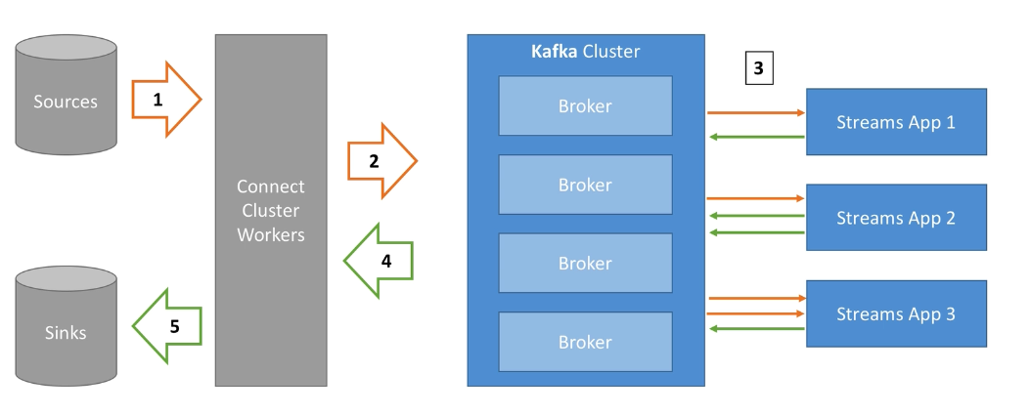
What is Kafka Streams

Slide 85
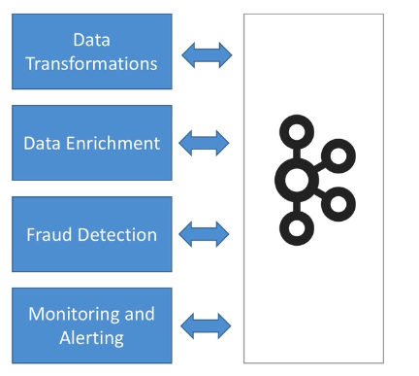
What is Kafka Streams
Easy data processing and transformation library within Kafka
Standard Application
No need to create a separate cluster
Highly scalable, elastic and fault tolerant
Exactly Once Capabilities
One record at a time processing (no batching)
Works for any application size

Slide 86
Kafka Streams histroy
The API/Library was introduced as part og Kafka 0.10 (XX 2016)
It’s was the only library to support this capability at the time
It is a serious contender to other processing frameworks such as Apache Spark, Flink or NiFi
Some comparisons to the other libraries
Micro Batch vs per data streaming
Cluster required vs no cluster required
Scales easily by just adding processes (no re-configurations required)
Made by the same people as kafka so therefore better support

Slide 87
Running our first kafka streams application
We will run one of kafkas example applications called WordCountDemo
It’s a simple stream application that counts words in a topic and prints out a count for number of times it has been mentioned.
More examples here:
https://github.com/confluentinc/kafka-streams-examples/tree/master
Go to folder Workshop3/1 – Streams Intro

Slide 88
Lets understand what it does
Understand fundementals of Kafka Streams (Topology Theory)
Understand basic Kafka Streams configurations
Learn about Kafka Streams App internal topics

Slide 89
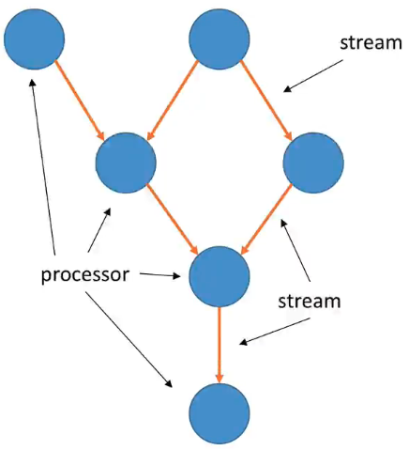
Kafka Streams – Core Concepts
A stream is a sequence of immutable data records that fully ordered can be replayed and is fault torelrant (So a Kafka Topic)
A stream processor is a node in the processor topology (graph). It transforms incoming streams, records by record, and may create new stream from it
A Topology is a graph of processors chained togehter

Slide 90
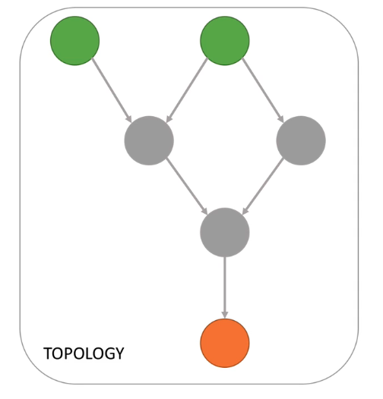
Kafka Streams – Core Concepts
A Source Processor is a special processor that takes its data directly from a Kafka topic. It has no predecessors in a topology, and doesn’t transform the data
A sink processors is processors that does not have children, it sends the stream data directly to a Kafka topic.

Slide 91
Kafka streams – Writing a toplology
We will use the High level DSL
Its simple
It has all the operations we need to perform most transformations tasks
It containts a lot of syntax helpers to make our life easy
It wil keep us busy for a while
Its descriptive
There is low Level Processor API(not part of this workshop)
Its an imperative API
Can be used to implement the most ocmplex logic, but it’s rearly needed.

Slide 92
Kafka Streams – App properties
A stream application is leveraging the Consumer and Producer API
Therefore all the configurations we learned before are still applicable
boostrap.servers: need to connect to kafka (localhost:19092)
auto.offset.reset.config: set to ”earliest” to consume from the start
application.id: specific to streams applciaiton, will be used for
Consumer group.id = application.id (Most important to remember!)
Default client_id prefix
Prefix to internal changelog topics
default.[key|value].serde: (For Serialization and Deserialization of Data)

Slide 93
Kafka Streams – Word Count Topology
Lets write the topology using the High Level DSL for our application
Remember data in Kafka Streams is <Key, Value>
Stream from Kafka
MapValues lowercase
FlatMapValues split by space
SelectKey to apply a key
GroupByKey before aggregation
Count occurrences in each group
To in order to write the resulsts back to Kafka
<null, “Kafka Kafka Streams”>
<null, “kafka kafka streams”>
<null, “kafka”>, <null,”kafka”>,<null, “streams”>
< kafka, “kafka”>, < kafka,”kafka”>,< streams, “streams”>
(< kafka, “kafka”>, < kafka,”kafka”>), (< streams, “streams”>)
< kafka, 2>, < streams,1>
Data point is written to Kafka

Slide 94
Kafka Stream – Internal topics
Running a Kafka Streams may eventually create internal intermediary topics
Two types:
Repartitioning topics: In case you start transforming the key of your stream, a repartitioning will happen at some processor.
Changelog topics: in case you perform aggregations, Kafka Streams will save compacted data in these topics
Internal topics:
Are managed by Kafka Streams
Are used by Kafka Streams to save / restore state and re-partition data
Are prefixed by application.id parameter
Should never be deleted, altered or published to. They are internal!

Slide 95
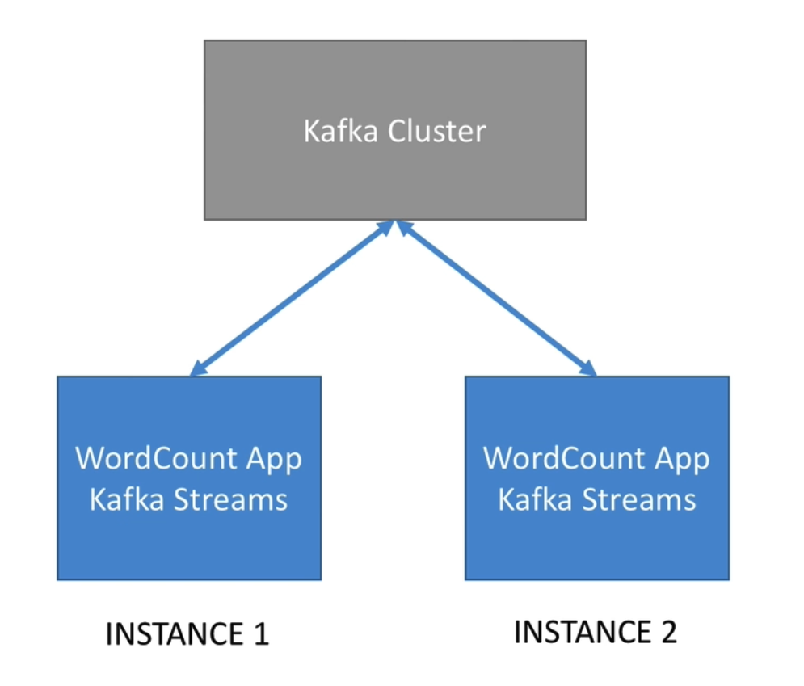
Kafka Streams - Scaling
Just like kafka consumers, number of partitons in a topic is the number of applications you can run in parallell
This makes scaling super easy!
Create a topic with 3,4,5 partions and run just as many streams applicaitions to see this in action.

Slide 96
Kafka Steams - Summary
Learned most important configuration parameters
Learned about the fundamental concepts of a topology
We learned how stream application scale
We learned about the importance of internal topics

Slide 97
Short break

Slide 98
Let’s Play
Inspirert av NAV’s: https://navikt.github.io/leesah-game/
Starter code for your language:
Workshop3/2 – Game

Slide 99
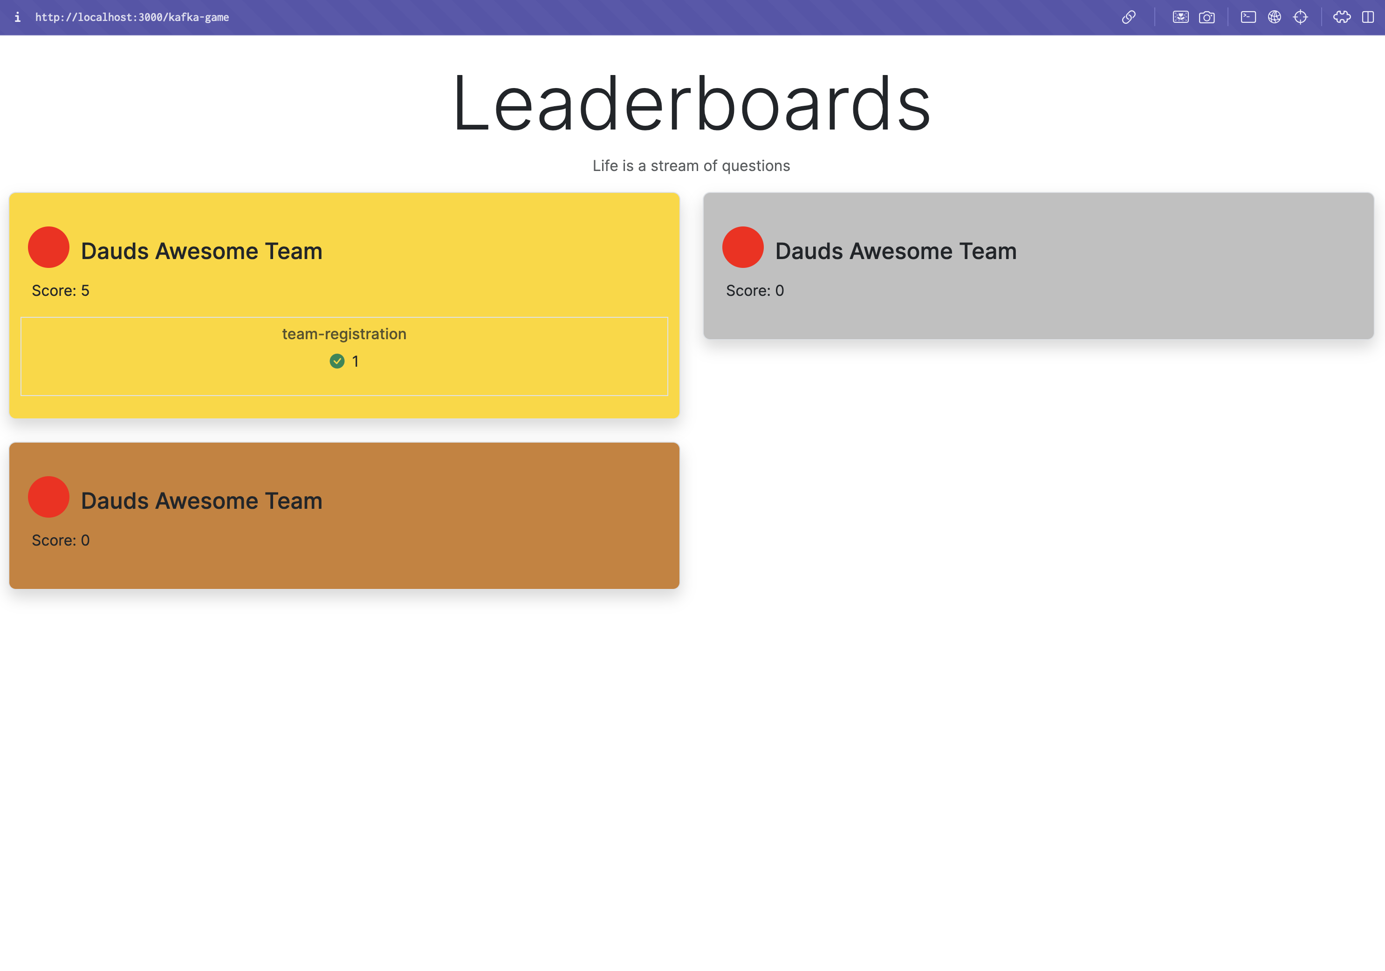
Letsplay.daud.dev (leaderboard for the game)

Slide 100
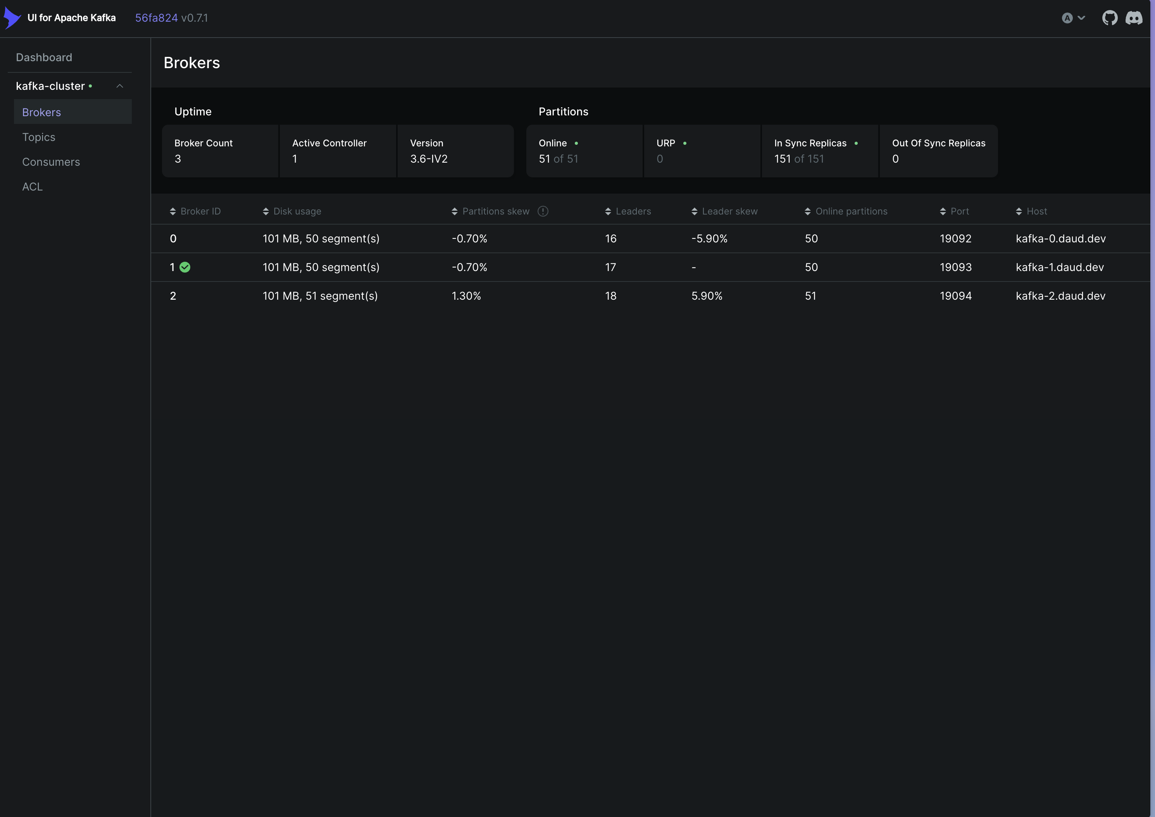
Kafka-ui.daud.dev (UI for kafka)
Bootstrap servers:
Kafka.daud.dev:19092
Kafka.daud.dev:19093
Kafka.daud.dev:19094
Game Topic
kafka-game

Slide 101
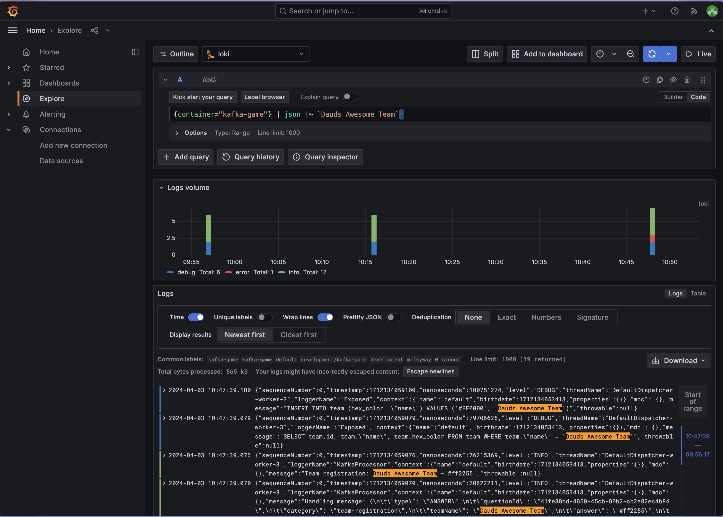
Grafana.daud.dev (Logs for debugging)
Access logs to game
User: kafka-workshop
Pass: Test1234
Explore tab
To find logs for your team search
{container="kafka-game"} | json |~ `<teamName>`

Slide 102
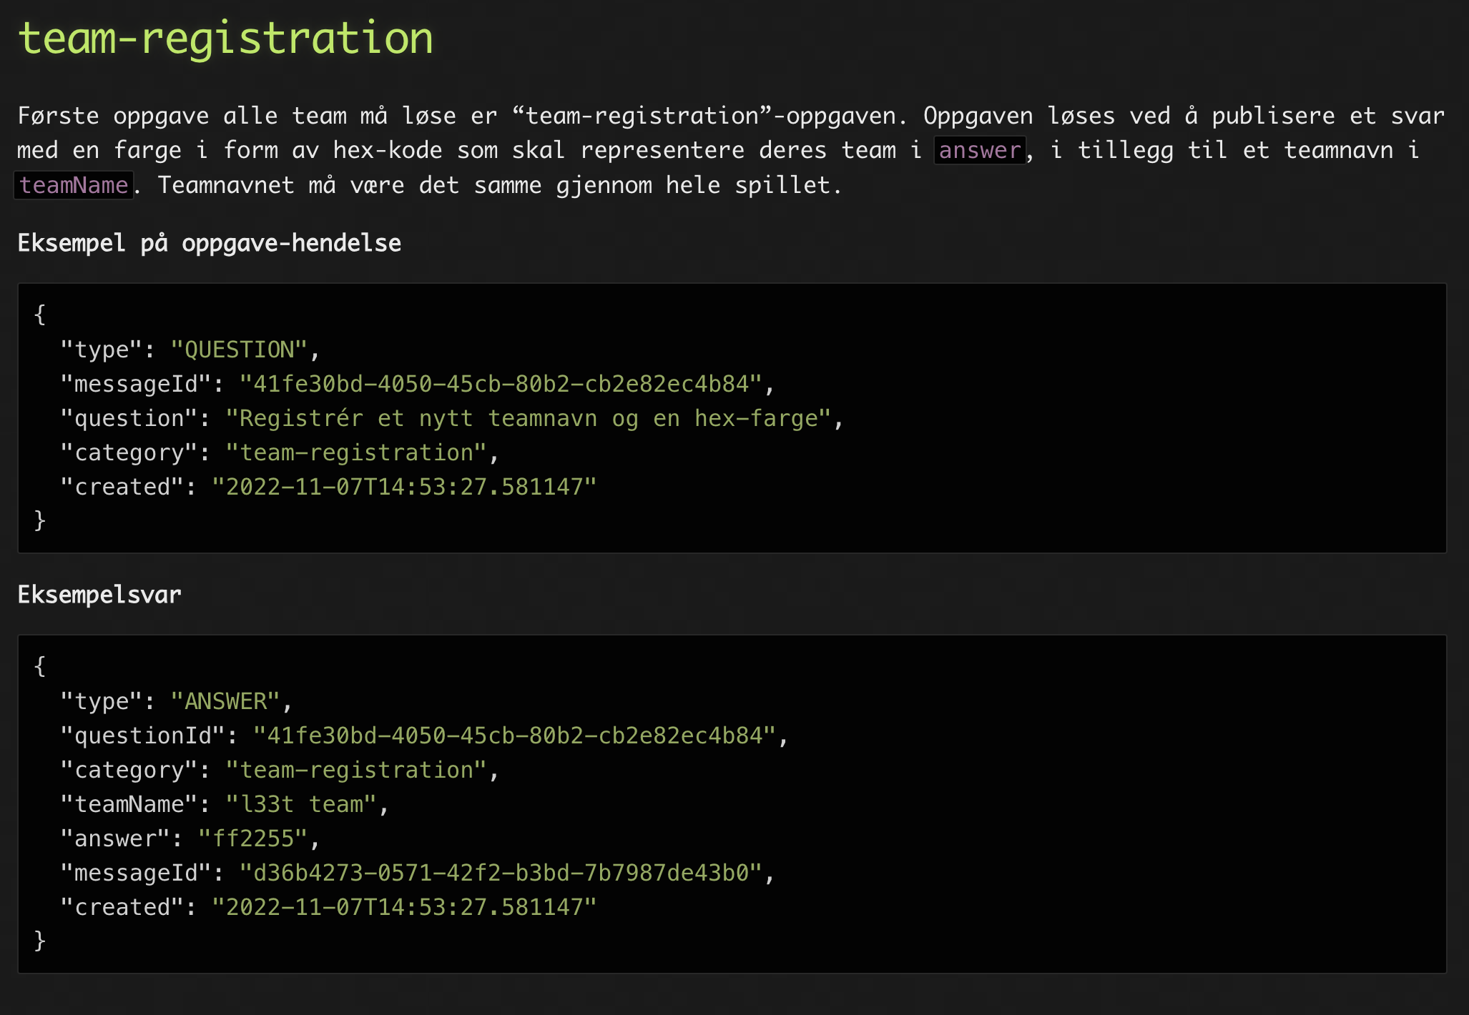

Slide 103
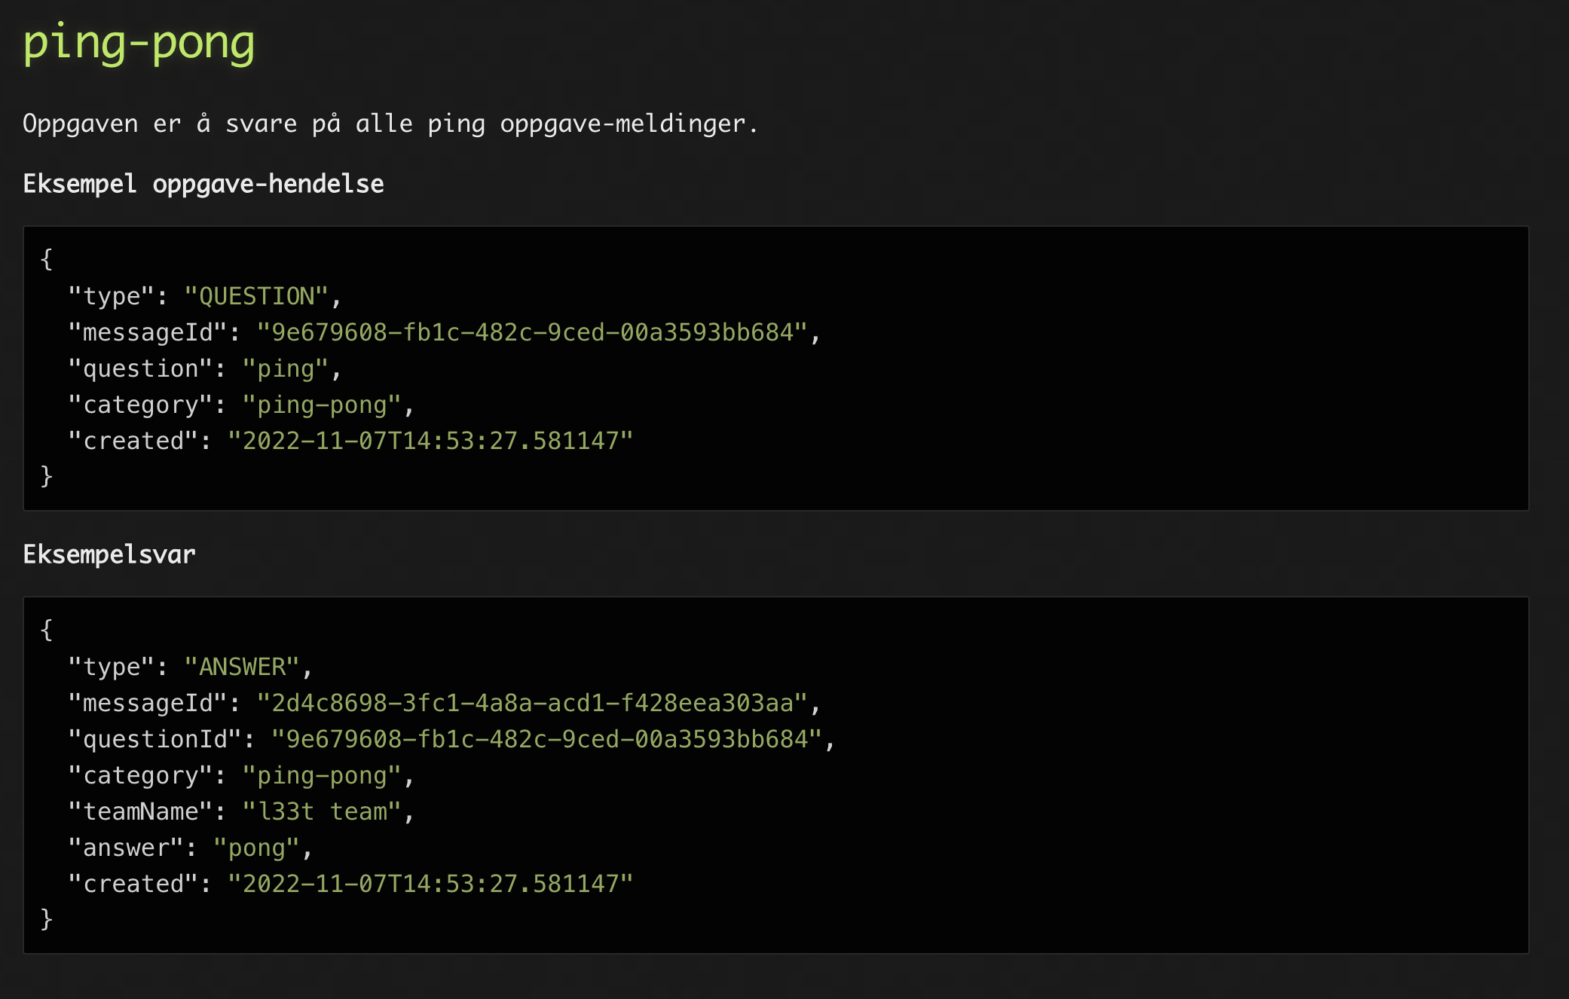

Slide 104
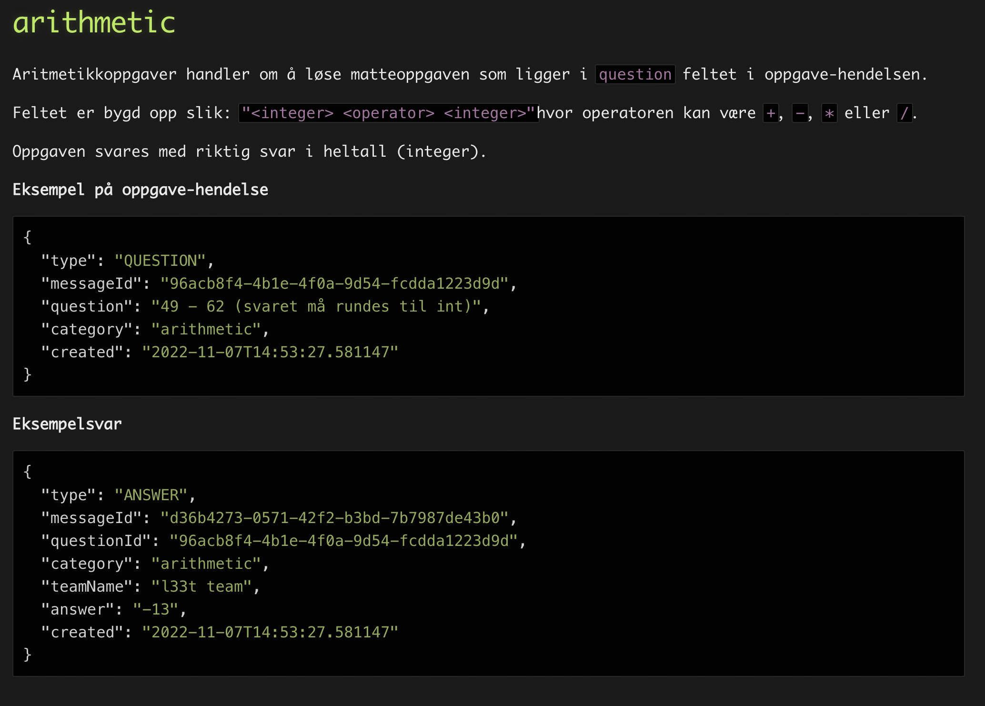

Slide 105


Slide 106


Slide 107


Slide 108


Slide 109


Slide 110


